Slide 1







Web Programming PHP&MySQL
FSTM KUIS

Slide 2

T00 PHP + LARAGON
bit.ly/fstmtube

Slide 3




3-tier
Tier3 : Database
Tier1 : Client/browser
Tier2 : Middleware (Webserver + PHP)

Slide 4


T1: CLIENT (BROWSER HTML)
The User-interface

Slide 5

T2: Web server + PHP interpreter
Hold logic/ business process
Server-side scripting
Dynamic web

Slide 6

T3: DATABASE
Place to hold database/records/data

Slide 7

LARAGON.ORG
Development stack
https://laragon.org/download.html
Apache/ Nginx / PHP/ MySQL / NodeJS / etc…

Slide 8
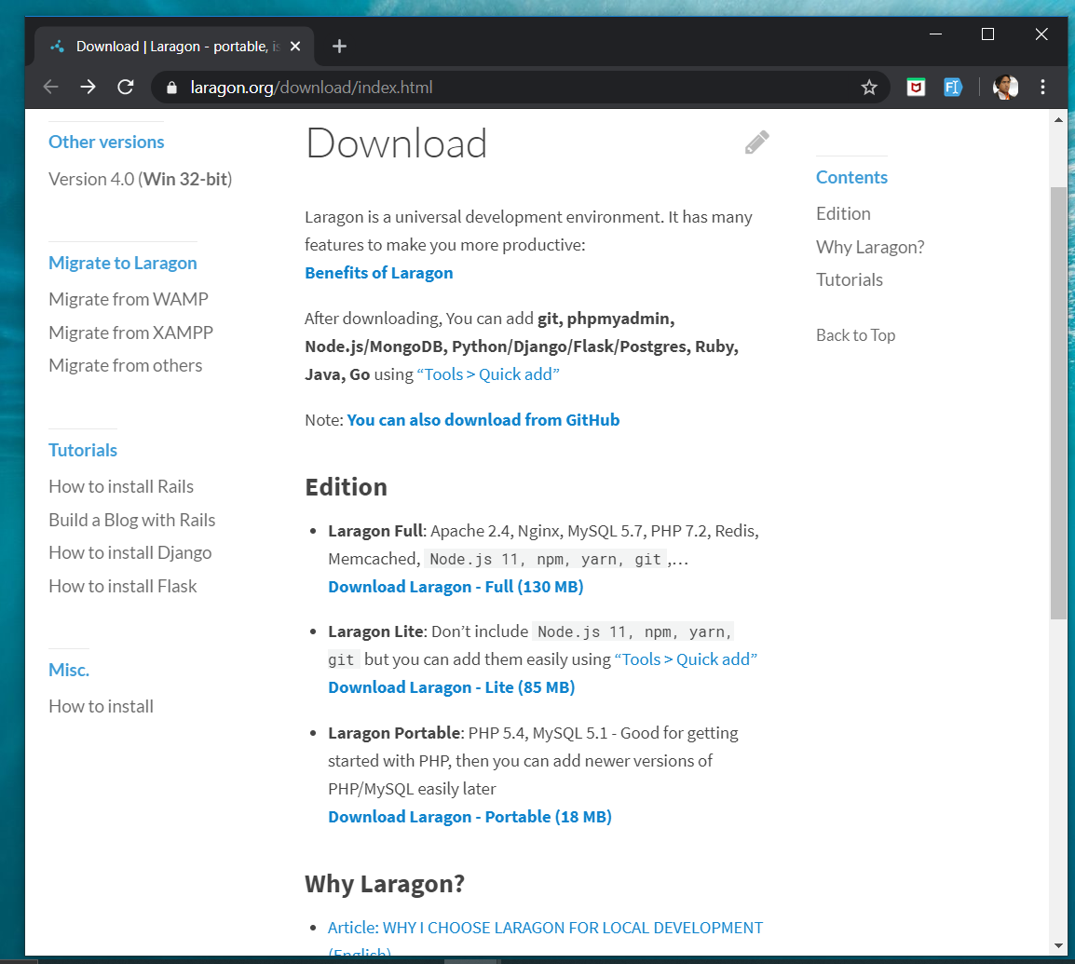
DOWNLOAD FROM LARAGON.org
Laragon.org

Slide 9
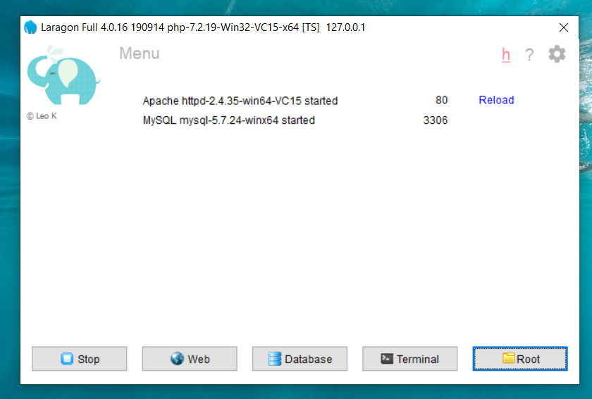
LARAGON INTERFACE
Start/stop servers
localhost
db client (HeidiSQL)
cli/npm/composer
go to webroot folder

Slide 10
T01 HTML5 & Bootstrap (Web Programming)
FSTM KUIS

Slide 11
T01 HTML5
w
bit.ly/fstmtube

Slide 12
Training outline
HTML5 – refers to the modern day of HTML which promotes native handling of video & audio & animation without having to install additional plugins to browser.
Bootstrap – A HTML framework supports responsive web design to provide one time webpage development for smartphone, tablet and desktop.

Slide 13
HTML5
HTML5 – refers to the modern day of HTML which promotes native handling of video & audio & animation without having to install additional plugins to browser.
<!DOCTYPE html>
Try: https://www.w3schools.com/html/tryit.asp?filename=tryhtml_headings

Slide 14
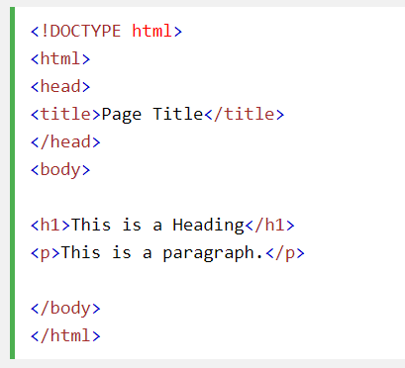
Typical HTML CODE

Slide 15
HTML5 image handling
<img src="pic_mountain.jpg" alt="Mountain View" style="width:304px;height:228px;">
Use width 100% to support responsive layout design.
Try: https://www.w3schools.com/html/tryit.asp?filename=tryhtml_images_trulli

Slide 16
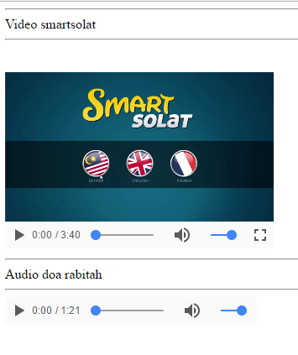
HTML5 Native video
<video width="320" height="240" controls> <source src="movie.mp4" type="video/mp4"> <source src="movie.ogg" type="video/ogg"> Your browser does not support the video tag. </video>
Try: https://www.w3schools.com/html/tryit.asp?filename=tryhtml5_video

Slide 17
HTML5 Native AUDIO
<audio controls> <source src="horse.ogg" type="audio/ogg"> <source src="horse.mp3" type="audio/mpeg"> Your browser does not support the audio element. </audio>

Slide 18
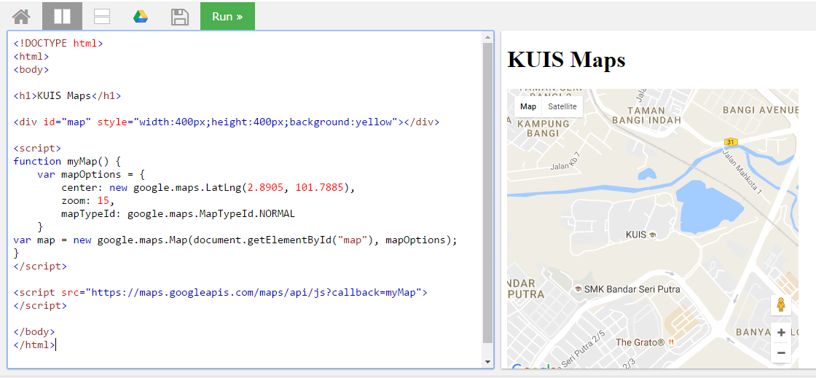
Location MAPS

Slide 19
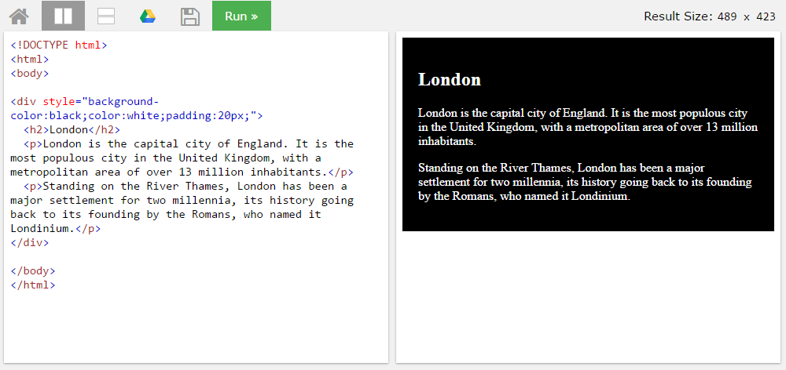
BLOCK <DIV>

Slide 20
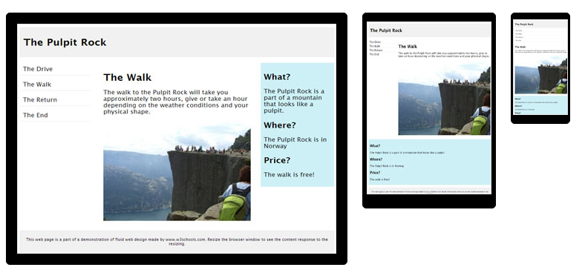
HTML Responsive layout

Slide 21
HTML Responsive layout
What is Responsive Web Design?
Responsive Web Design makes your web page look good on all devices (desktops, tablets, and phones).
Responsive Web Design is about using CSS and HTML to resize, hide, shrink, enlarge, or move the content to make it look good on any screen

Slide 22
VIEWPORT
<meta name="viewport" content="width=device-width, initial-scale=1">
The viewport varies with the device, and will be smaller on a mobile phone than on a computer screen.
The initial-scale=1.0 part sets the initial zoom level when the page is first loaded by the browser.

Slide 23
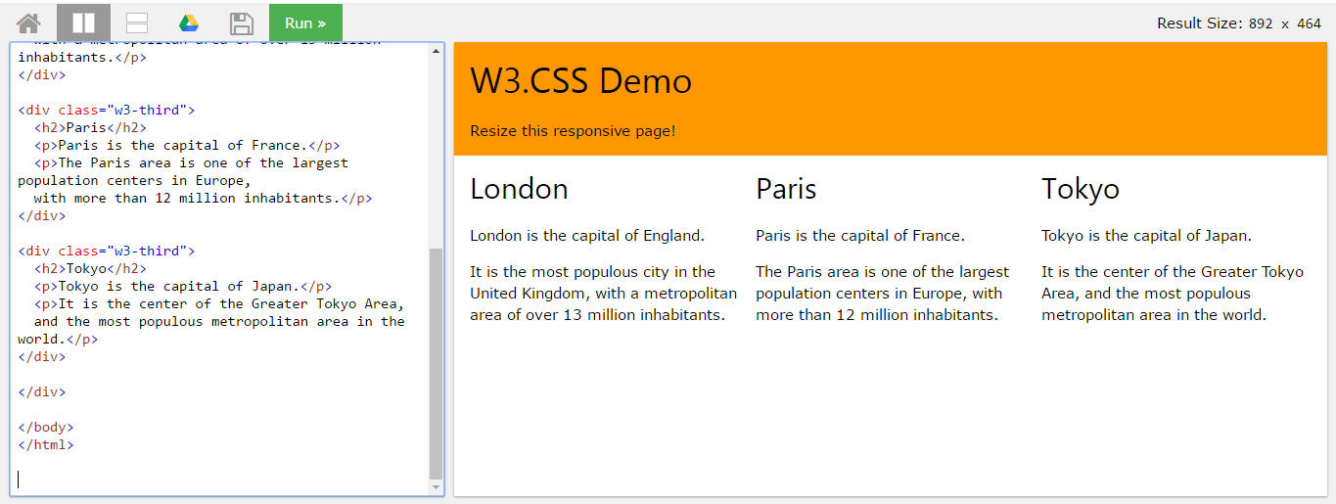
HTML Responsive layout

Slide 24
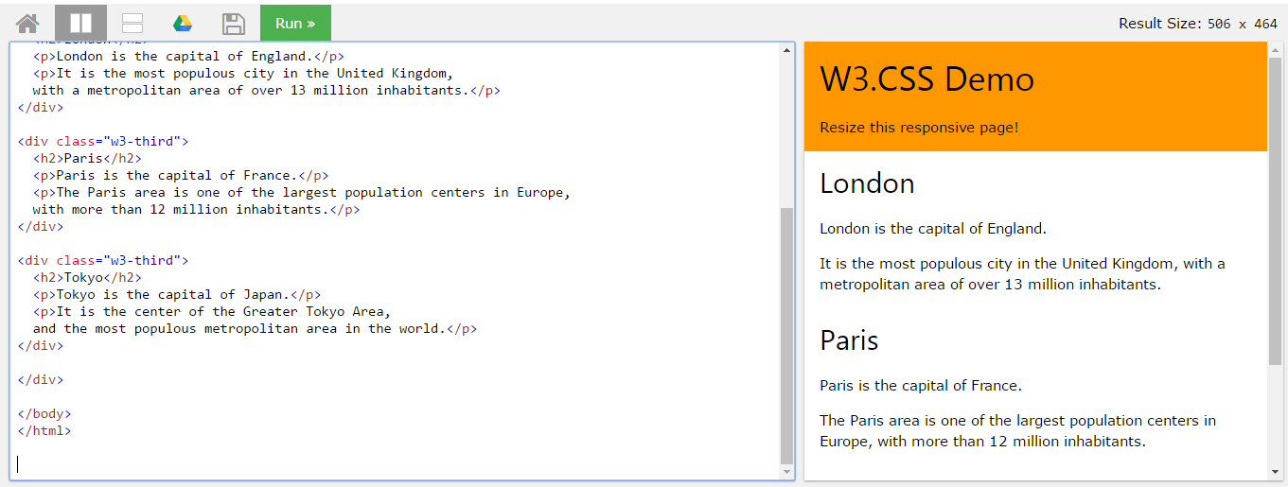
HTML Responsive layout

Slide 25
T02 Bootstrap + PHP Include
FSTM KUIS

Slide 26
T02 BOOTSTRAP + PHP include
FSTM KUIS

Slide 27

Bootstrap
A HTML framework supports responsive web design to provide one time webpage development for smartphone, tablet and desktop.

Slide 28
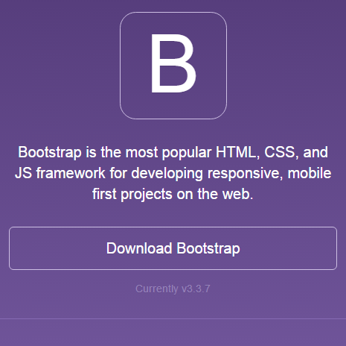
Bootstrap
Download framework from getbootstrap.com
OR use the CDN

Slide 29
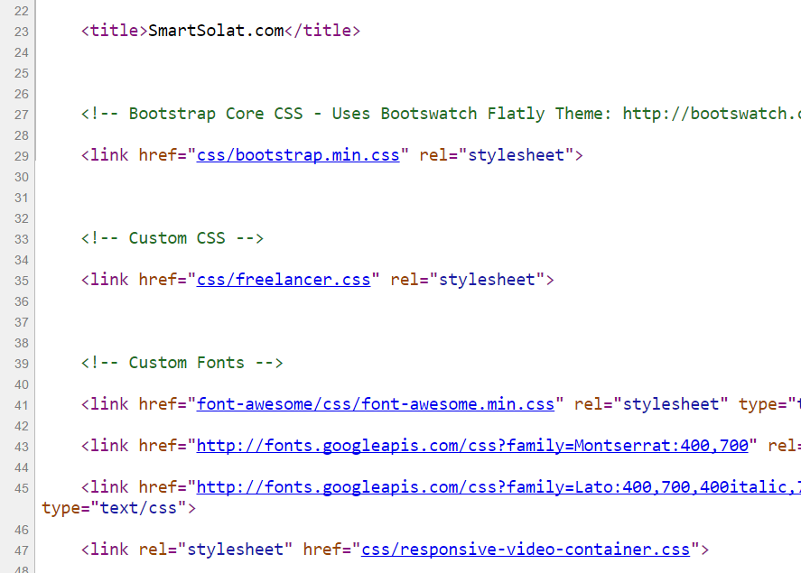
Bootstrap -setting
Copy the CSS script to the project folder.
> OR we can use CDN server

Slide 30
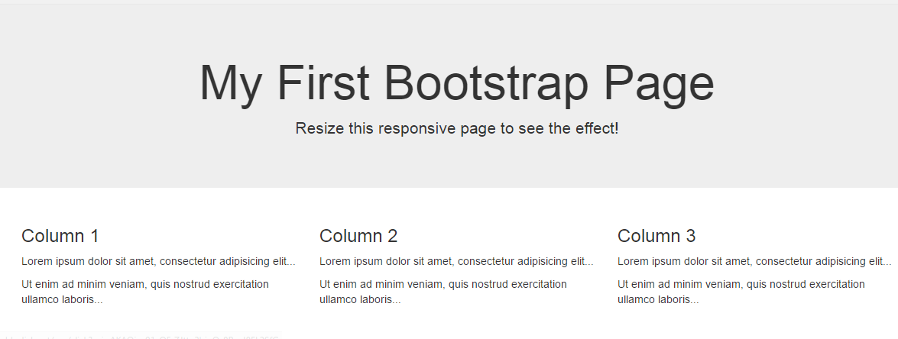
Basic bootstrap layout
Try it here http://www.w3schools.com/bootstrap/tryit.asp?filename=trybs_default&stacked=h

Slide 31
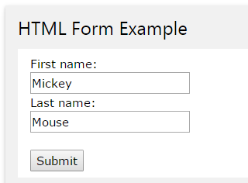
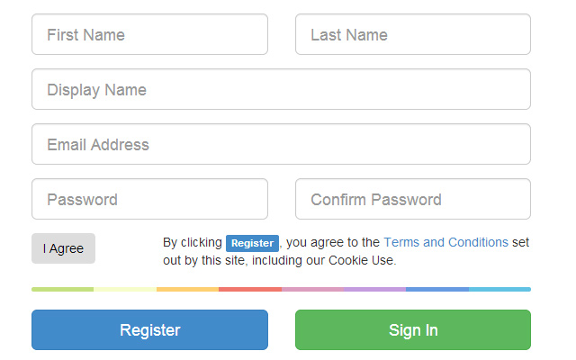
BOOTSTRAP FORM

Slide 32
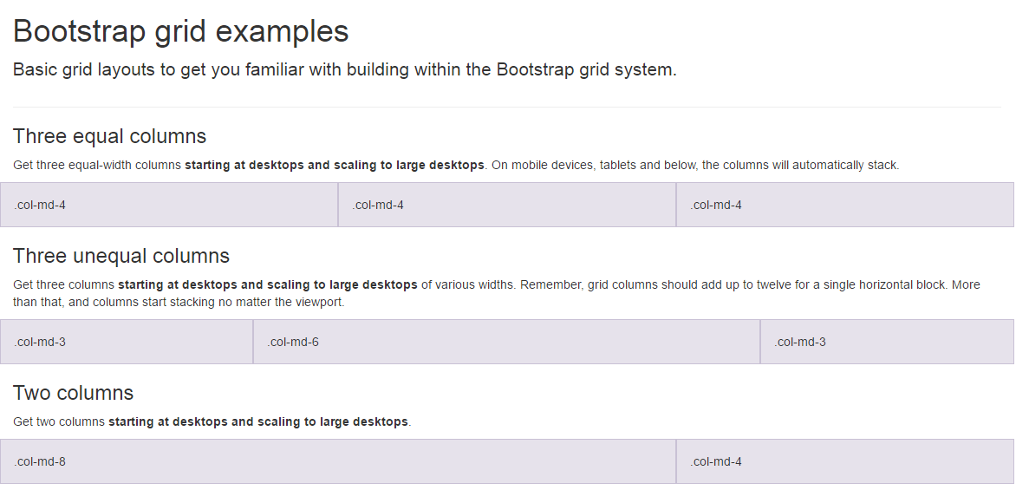
BootSTRAP GRID SYSTEM

Slide 33
BootSTRAP GRID SYSTEM DESKTOP
Banner
Main Content
Sidebar
Footer

Slide 34
BootSTRAP GRID SYSTEM MOBILE
Banner
Main Content
Sidebar
Footer

Slide 35
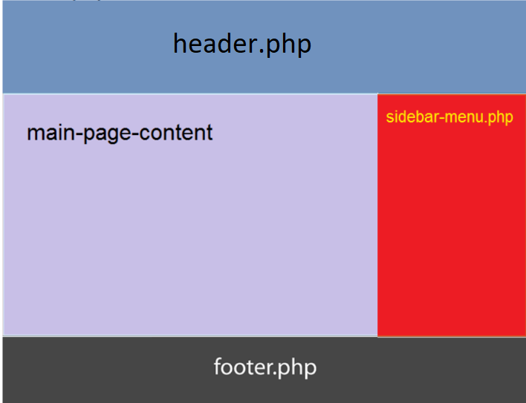
Include php
include (“header.php”);
<our content>
include (“footer.php”);

Slide 36

FREE STARTbootstrap.com
Example https://startbootstrap.com/

Slide 37
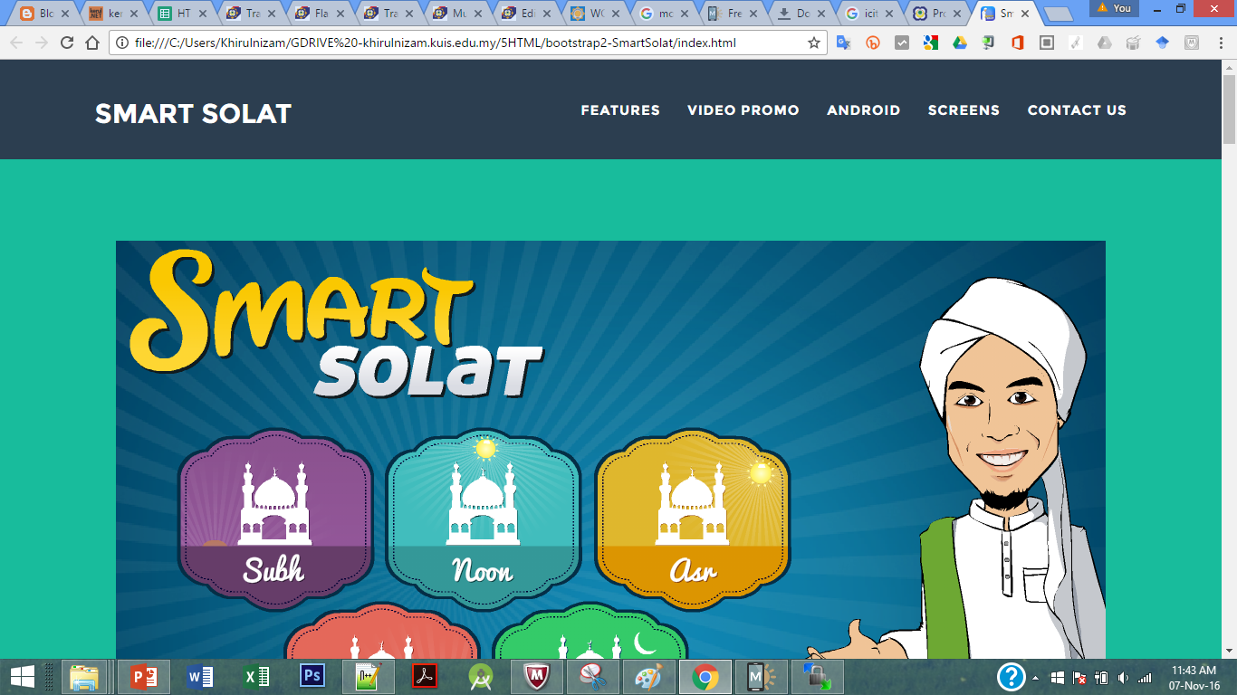
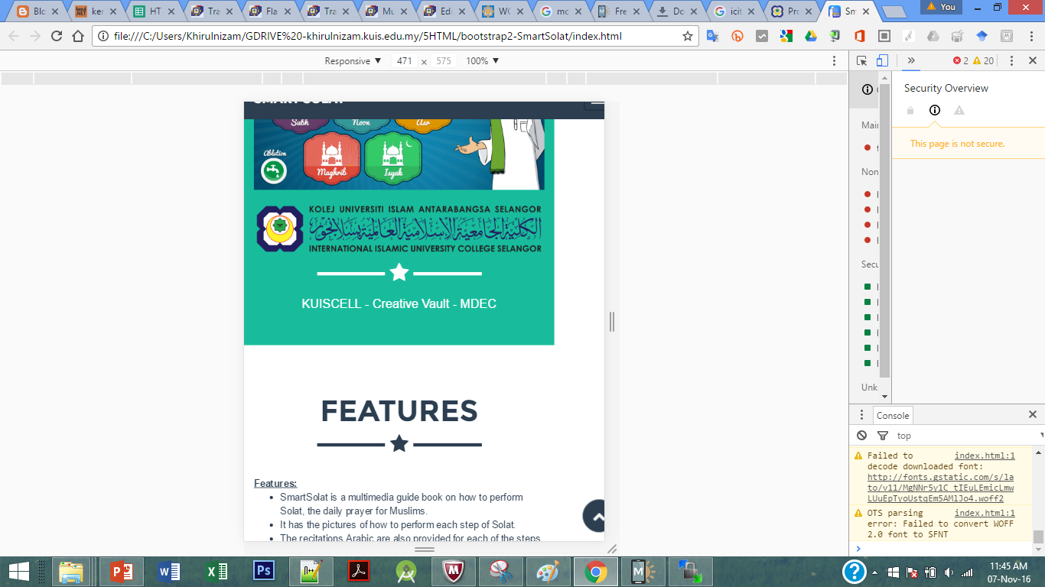
Sample2 - smartsolat

Slide 38
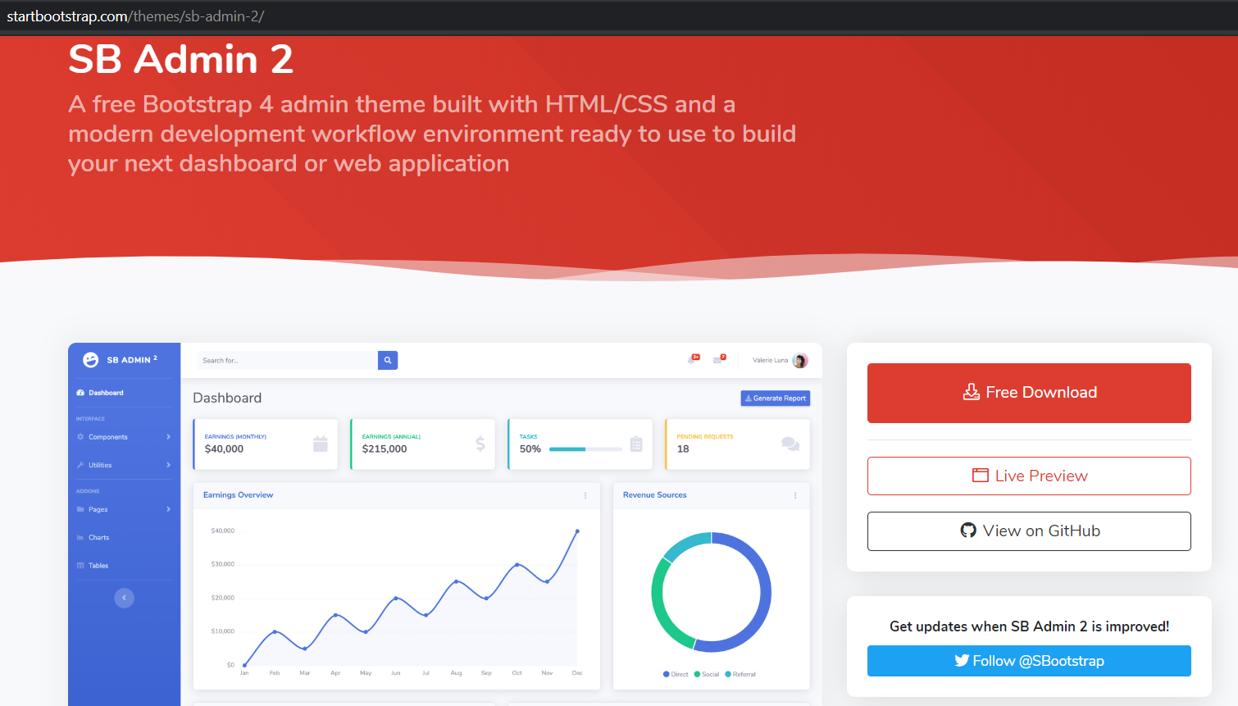
startbootstrap.com/themes/sb-admin-2/

Slide 39

T02.1 HTML + Bootstrap Form (Web Programming)
bit.ly/fstmtubephp

Slide 40
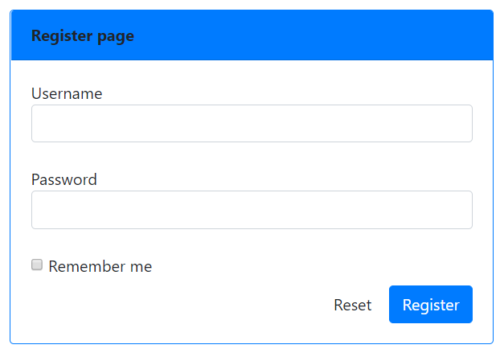
OUTPUT PREVIEW

Slide 41

DISCLAIMER
Codes are for demo purposes. Example showed here are only to validate the proof of concepts. Security aspect the demonstrated examples are beyond the coverage of these video tutorials. You are advised to explore / sought after advanced/security topics of PHP web programming as these tutorials only for beginner level.
Suitable to view in DESKTOP

Slide 42

CONNECT TO MYSQL DATABASE
mysqli
E-book PHP&Mysqli get it from
khirulnizam@gmail.com or
http://fb.com/khirulnizam or
Instagram @kerul_net
Video tutorial will cover mysqli

Slide 43
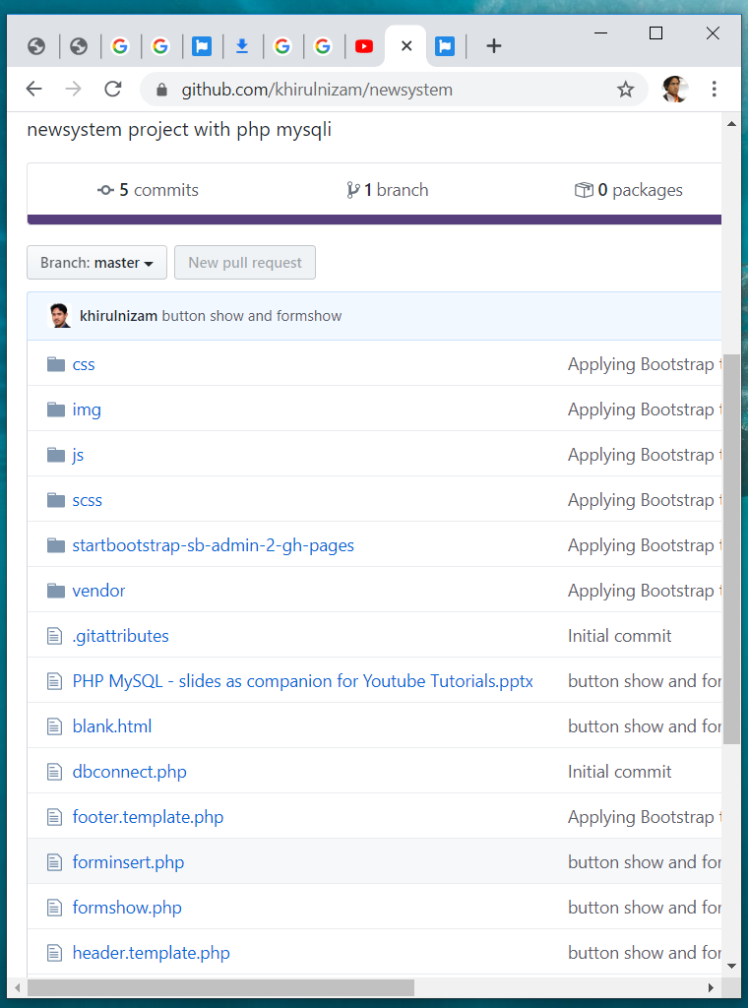

Code & Slides github.com/khirulnizam/ newsystem

Slide 44
BOOTSTRAP FORM

Slide 45
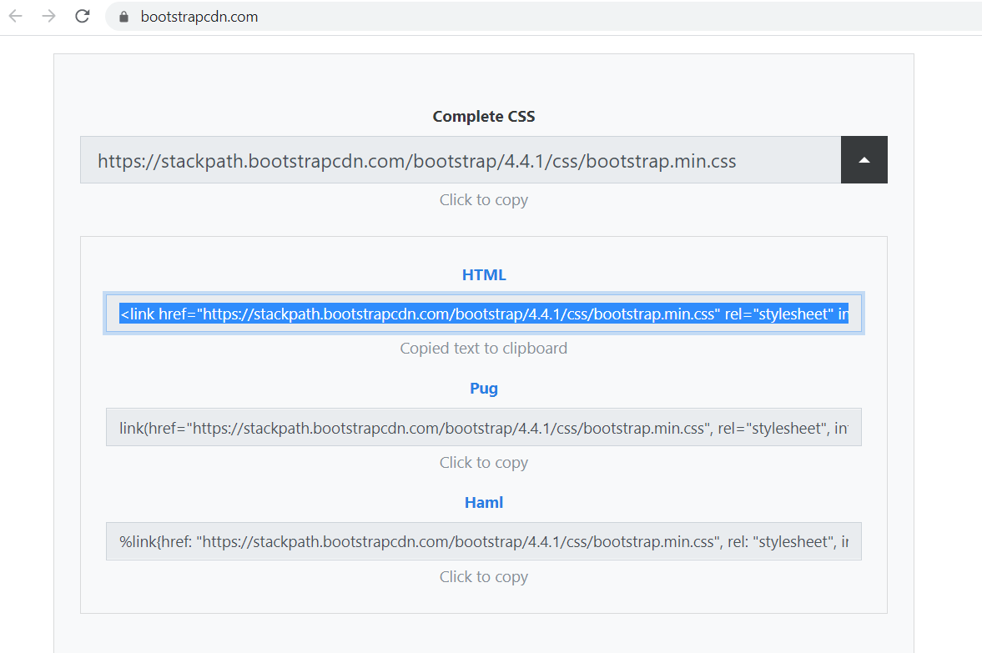
BootstrapCDN.com

Slide 46
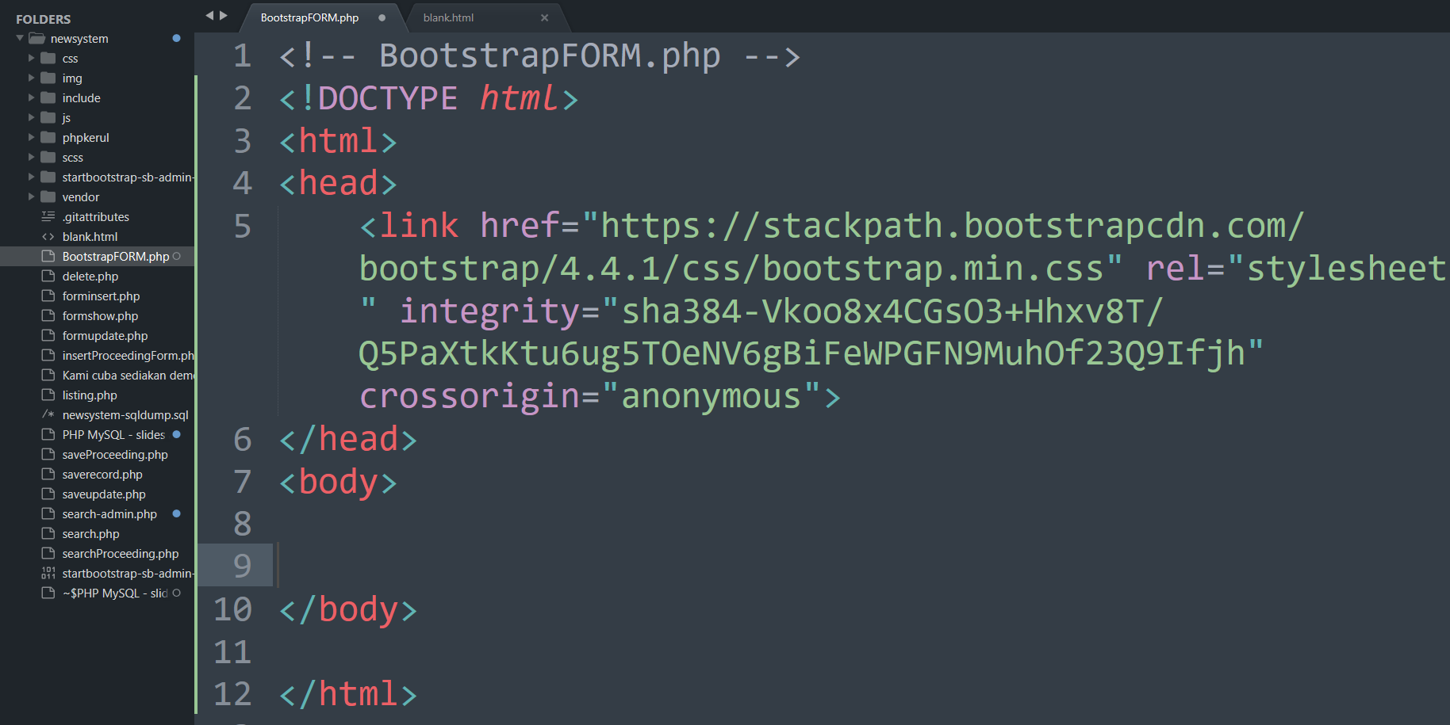

Slide 47
BootSTRAP GRID SYSTEM

Slide 48
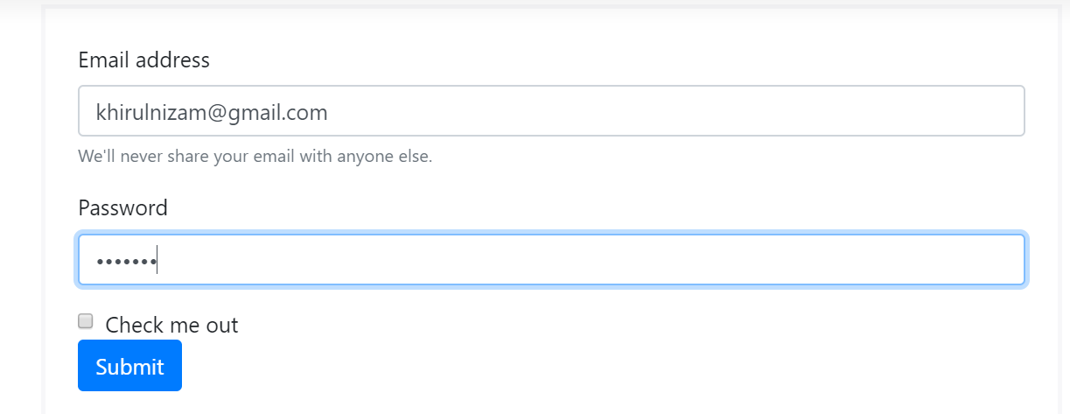
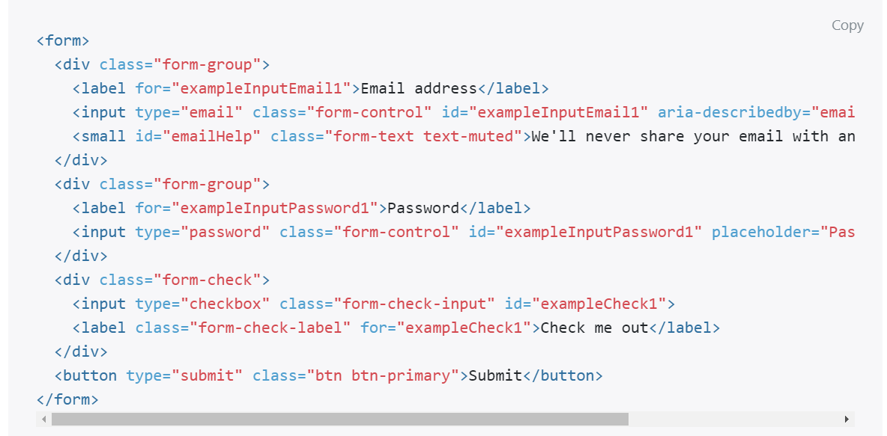
Email & PASSWORD

Slide 49
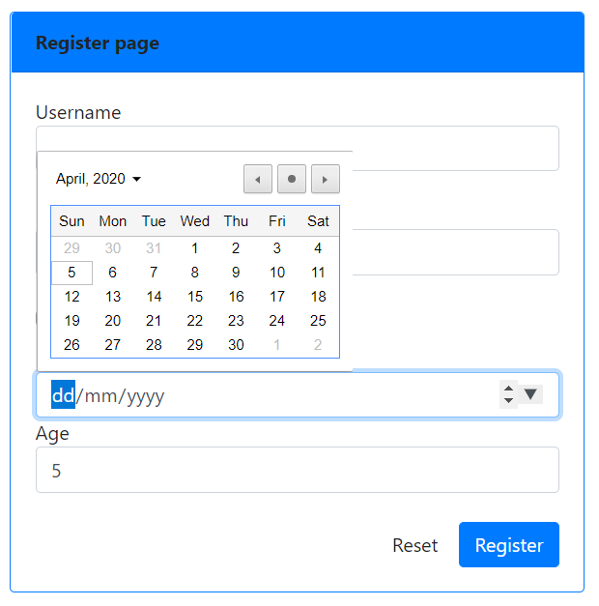
Date & NUMBER
<div >
Date of birth
<input type="date" name="dob" class="form-control">
Age
<input type="number" name="age" class="form-control">
</div>

Slide 50
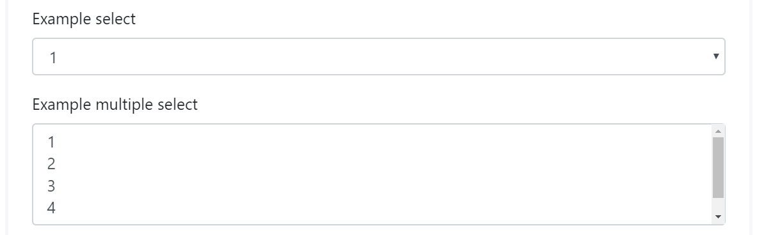
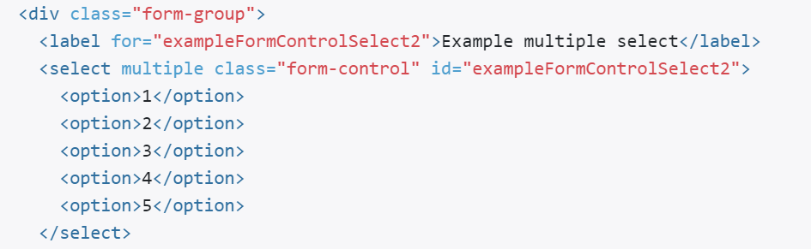
SELECT (DROP-DOWN)

Slide 51
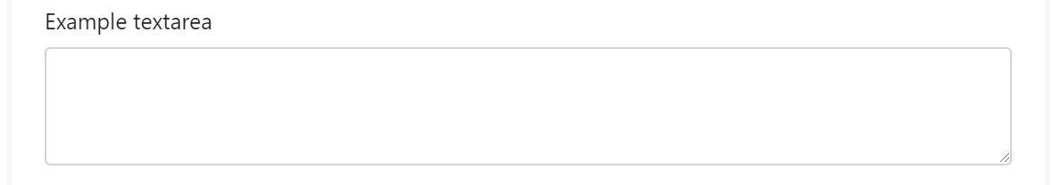
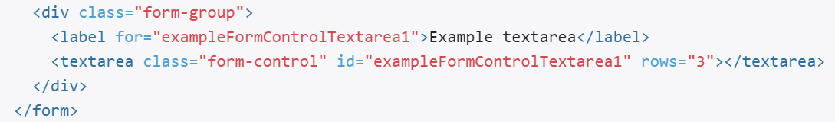
TEXTAREA

Slide 52
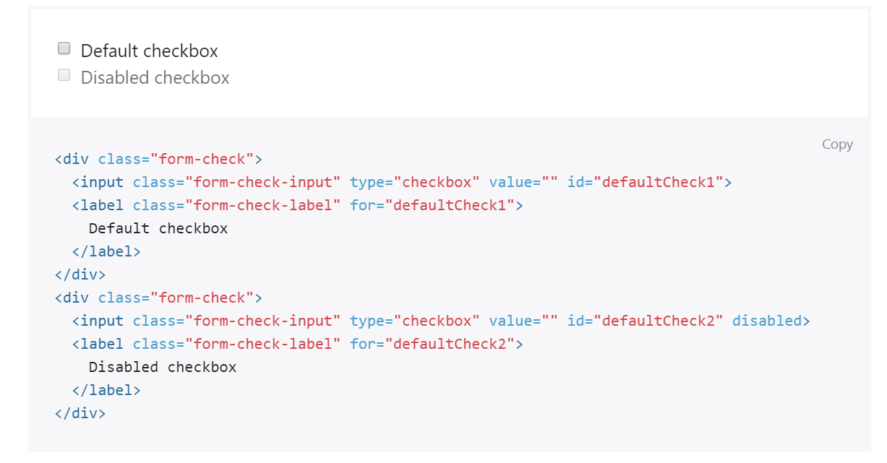
CHECKBOX

Slide 53
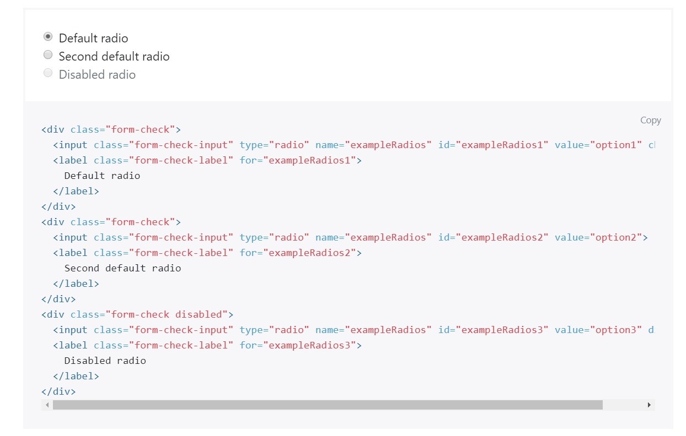
RADIO

Slide 54
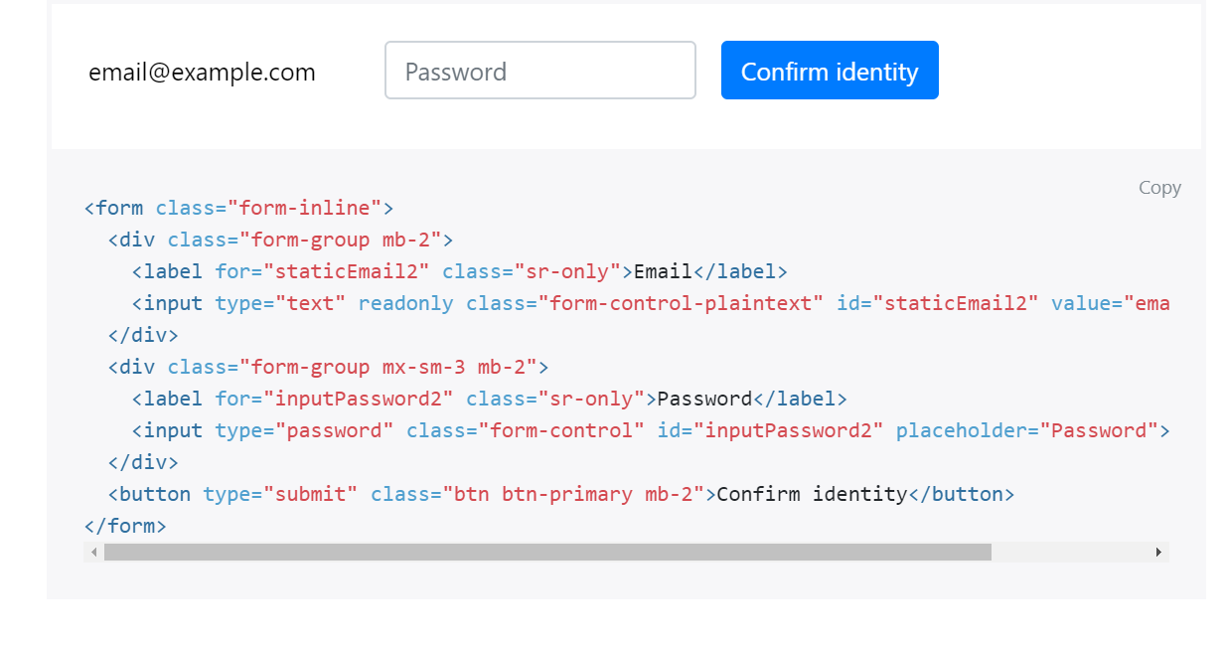
FORM-INLINE

Slide 55
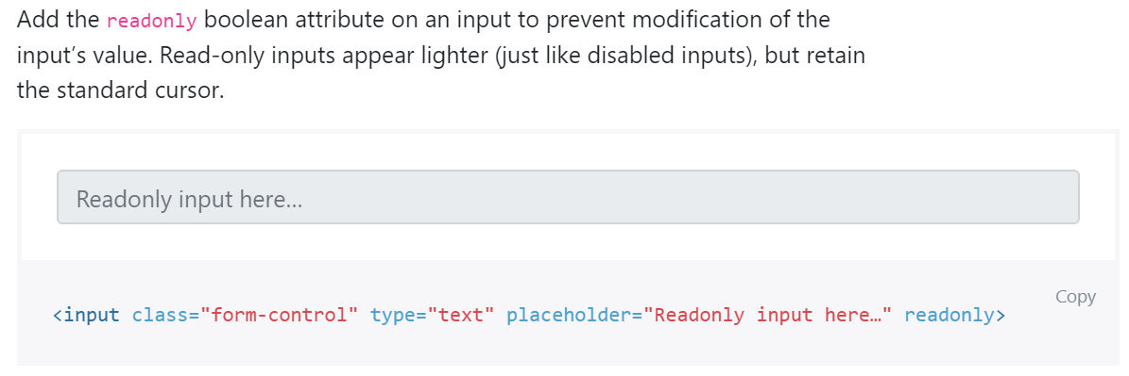
READONLY

Slide 56
DISABLED

Slide 57
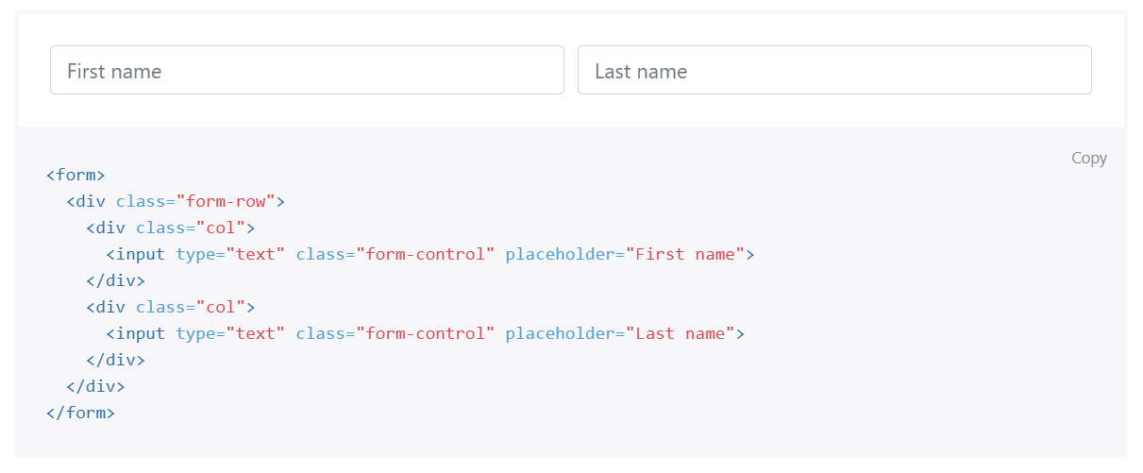
FROM GRID

Slide 58
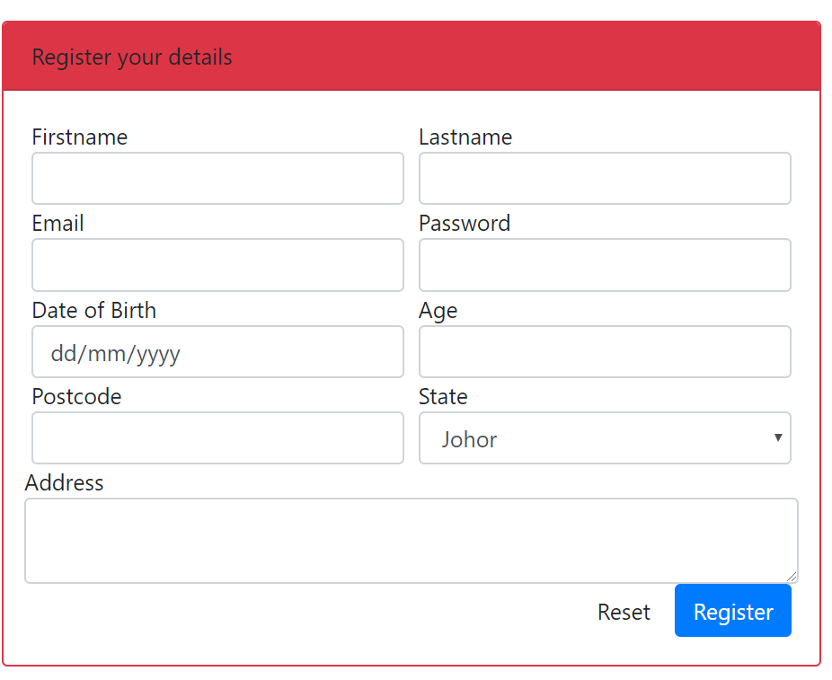
OUTPUT PREVIEW

Slide 59
T03: PHP sintaks & echo (Web Programming)
FSTM KUIS

Slide 60
T03: PHP SYNTAX & ECHO
w
FSTM KUIS

Slide 61
Introduction
What is Web programming:
Combination of server-side and client-side to develop a dynamic website.
The application is deployed in the Web environment and can be access by multiple concurrent users.

Slide 62
Introduction to PHP
PHP= PHP: Hypertext Preprocessor:
Is a server-side scripting language.
PHP scripts are executed on the server, and the output from the process is inserted to the Web page as a part of the content before transmitted to the browser.
The script will not be sent to the browser which request the Web page, so the script is not visible to the users.

Slide 63
Introduction to PHP
Server-side Scripting | Client-side scripting
The script embedded inside the HTML page, interpreted and executed inside the server (the web server) and the result/output of the execution is sent to the browser. The script interpreted and executed inside the server. E.g.: PHP, ASP. | The script embedded inside the HTML page, downloaded with the HTML page and executed on the client (browser). E.g.: JavaScript.

Slide 64
Introduction to PHP
Why PHP?
Runs on different platforms (Windows, Linux, Unix, etc.).
Is compatible with almost all servers used today (Apache, IIS, etc.).
Is free to download.
Is easier to learn and runs efficiently on the server side.

Slide 65
PHP Script Tag
A PHP scripting block always starts with <?php and ends with ?>
A PHP scripting block can be placed anywhere in the document.
On servers with shorthand support enabled ( enable in php.ini) may start a scripting block with <? and end with ?>

Slide 66
PHP Script Tag
A PHP file normally contains HTML tags, just like an HTML file, and some PHP scripting code.
Next, we have an example of a simple PHP script which sends the text “Assalamualaikum" to the browser:

Slide 67
PHP Script Tag
<html>
<head>
<title> Web Programming </title>
</head>
<body>
<?php
echo "Assalamualaikum";
?>
</body>
</html>

Slide 68
PHP Script TAG
Each code line in PHP must end with a semicolon ( ; ).
The semicolon is a separator and is used to distinguish one set of instructions from another.

Slide 69
PHP Script Tag
There are two basic statements to output text with PHP: echo and print.
In the example before, we have used the echo statement to output the text "Assalamualaikum".

Slide 70
PHP ECHO
<?php
$txt="Assalamualaikum!";
$x=23;
echo "Assalamualaikum!";
echo $x;
?>

Slide 71
T04 PHP SYNTAX //comment & $variable
FSTM KUIS

Slide 72
Comments in PHP
Comment is remark inside code that will not be compiled (ignored when the program is compiled).
It will not effect the code.
It is a good practice to write the comment.
Comment is useful the tell others what is the program is doing.
Helps programmer to memorize what is he doing.

Slide 73
Comments in PHP
In PHP, we use:
// to make a single-line comment or
/* … */ to make a large comment block.

Slide 74
Comments in PHP
<html>
<head>
<title> Web Programming </title>
</head>
<body>
<?php //This is a comment /* This is a comment block */ ?>
</body>
</html>

Slide 75
T04 PHP SYNTAX $variable & concat
bit.ly/fstmtube

Slide 76
T05 SYNTAX PHP VARIABLES & CONCAT
w
FSTM KUIS

Slide 77
PHP Variables
Variables are used for storing values, like text strings, numbers or arrays.
When a variable is declared, it can be used over and over again in your script.
All variables in PHP start with a $ sign symbol.
The correct way of declaring a variable in PHP:
Eg: $var_name = "Kerul";

Slide 78
PHP Variables (cont)
New PHP programmers often forget the
$
sign at the beginning of the variable.
In that case it will not work.
Let's try creating a variable containing a string and a variable containing a number:

Slide 79
PHP Variables (cont)
<?php
$txt="Assalamualaikum!";
$x=23;
echo $txt;
?>

Slide 80
EXAMPLE ON VARIABLE
Write the echo( )statement to display the following message:
Assalamualaikum!23

Slide 81
Naming Rules for Variables
A variable name must start with a $
A variable name can only contain alpha-numeric characters and underscores (a-z, A-Z, 0-9, and _ ).
A variable name should contain no space.
If a variable name is more than one word, it should be separated with an underscore ($my_string), or with capitalization ($myString).

Slide 82
EXAMPLE
Decide whether the following variables are valid or invalid. Give your reason.
$apa 11) $my_books
$123lekuk 12) $_myFamily
$what-is-the-number 13) $my address
$_uji1 14) $my2numbers
$my name
$For
IF
$float
$variable_to_hold_names_or_matrix_for_students
$hasil*nombor

Slide 83
Lateral Values
Lateral is the exact/actual value.
The value could be number (integer or real), character, string, or Boolean.

Slide 84
Lateral Values (cont)
Integer:
Integer is round number.
For example, 10 is an integer.
E.g.:
$num = 10;
$num = -10;
Use negative sign for negative numbers.

Slide 85
Lateral Values (cont)
Float:
E.g.:
$temp = 21.1225;
$product = 0.0;

Slide 86
Lateral Values (cont)
Characters:
To assign a character value into a char variable, the value must be put inside a open and close single or double quote.
E.g.:
$nama = 'Encik';
$name = "Kerul";

Slide 87
Lateral Values (cont)
Boolean:
There are only two values for Boolean variable: true and false.
E.g.:
$eatalready = true;
$isInteger = false;

Slide 88
Lateral Values (cont)
String:
A group of characters.
Marked with single or double quote.
E.g.:
$stmt = "How are you";

Slide 89
Concatenation Operator
There is only one string operator in PHP.
The concatenation operator ( . ) is used to put two string values together.
To concatenate two string variables together, use the concatenation operator:

Slide 90
Concatenation (cont)
<?php $txt1="Assalamualaikum!"; $txt2="Have a nice day!";
echo $txt1 . " " . $txt2; ?>

Slide 91
Concatenation (cont)
The simpler way in doing concatenation:
<?php $txt1="Assalamualaikum!"; $txt2="Have a nice day!";
echo "$txt1 $txt2"; ?>

Slide 92
Concatenation (cont)
Or, if you want to print the output in a separate line:
<?php $txt1="Assalamualaikum!"; $txt2="Have a nice day!";
echo "$txt1 <br> $txt2"; ?>

Slide 93
Concatenation (cont)
Array:
<?php $num[0]=3;
echo "Number ".$num[0];
echo "Number $num[0] ";//not possible
?>

Slide 94
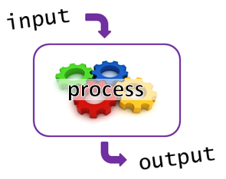
T05+1 Input Process Output
bit.ly/fstmtube

Slide 95
I-P-O
Input data
Process the data by converting into information
Output – convey the information as something meaningful

Slide 96
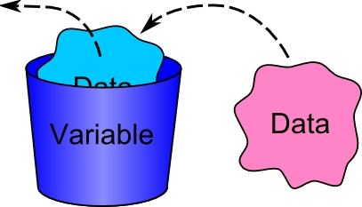
PHP Variables
Variables are used for storing values, like text strings, numbers or arrays.
All variables in PHP start with a $ sign symbol.
The correct way of declaring a variable in PHP:
Eg: $num1= 3; $num2=5;

Slide 97
Naming Rules for Variables
A variable name must start with a $
A variable name can only contain alpha-numeric characters and underscores (a-z, A-Z, 0-9, and _ ).
A variable name should contain no space.
If a variable name is more than one word, it should be separated with an underscore ($my_string), or with capitalization ($myString).

Slide 98
Arithmetic Operations
Operator | Operation | Example
 |  | Mathematical expression | PHP expression
+ | Addition | num1 + 3 | $total=$n1 + $n2;
- | Subtraction | pi - y | $q=$pi - $y;
* | Multiplication | width x height | $area=$width * $height;
/ | Division | a/b | $div=$a/$b;
% | Modulus | num modulo 2 | $even=$nom%3;

Slide 99
PROCESS: ADD 2 NUMBERS
Input process output
$num2 3
$num1 5
$total 8

Slide 100
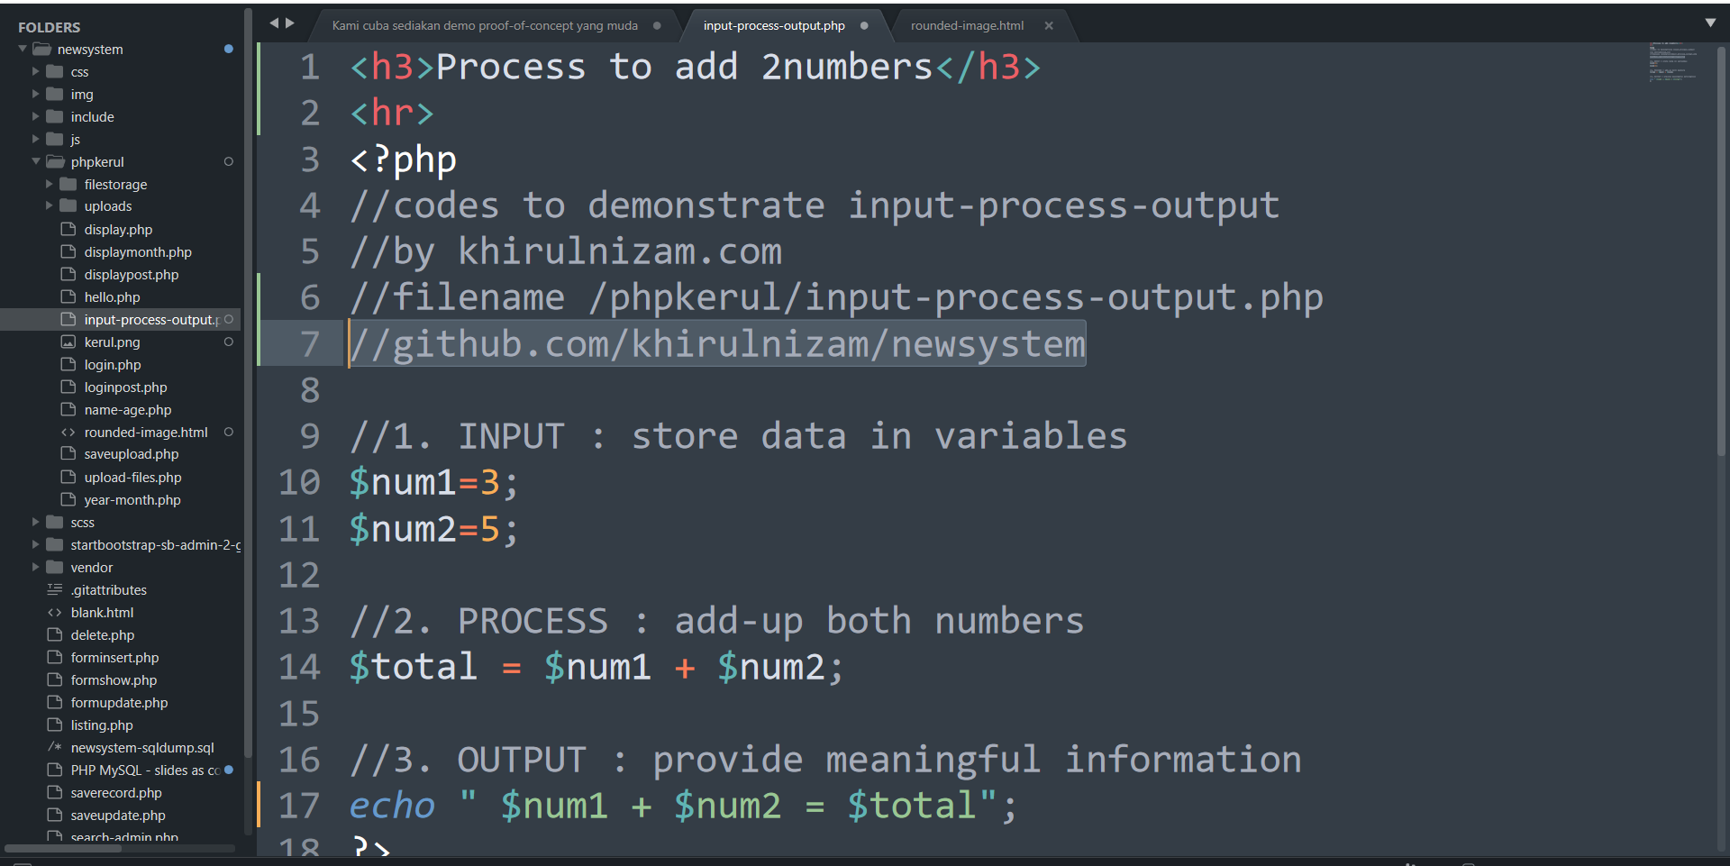
github.com/khirulnizam/newsystem

Slide 101
T06 FORM INPUT
w
bit.ly/fstmtube

Slide 102
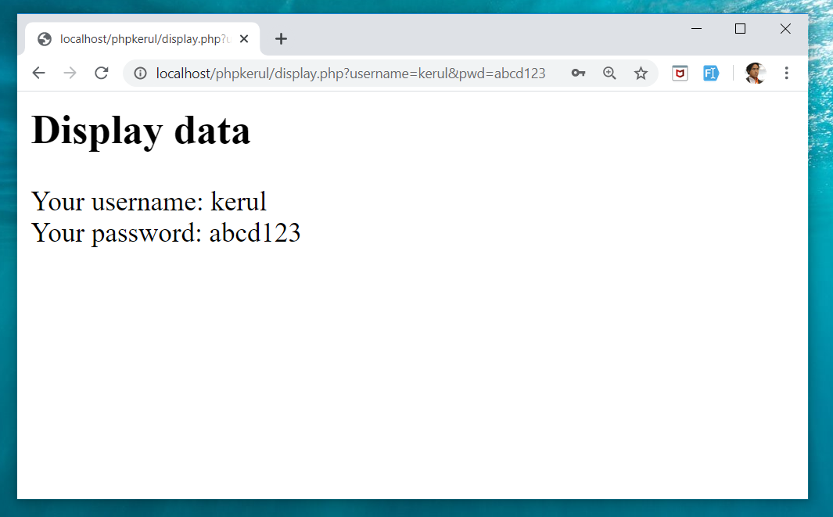
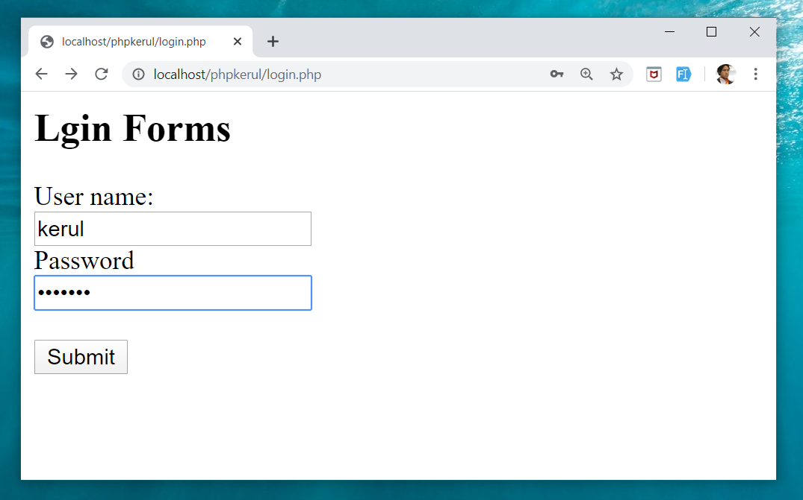
Example (cont)

Slide 103
Input Through HTML
<form name=“aform” method=“GET” action=“save.php”>
input…
</form>
This is the typical structure of form:
name: is the name of the form.
method: how the data is transferred (POST or GET).
action: is the target file resides in the Web server that receive the data from the form.
input: are the input elements (text field, checkbox, radio button, etc.).

Slide 104
GET vs. POST
GET | POST
Is basically for just getting (retrieving) data. The variable name and the value appear and visible in the URL. Form data is to be encoded (by a browser) into at the end of the URL of the target file. | Form data is embedded within a message body. POST may involve anything, like storing files to the server, updating data, ordering a product, or sending an e-mail. The variable name and the value do not appear in the URL.

Slide 105
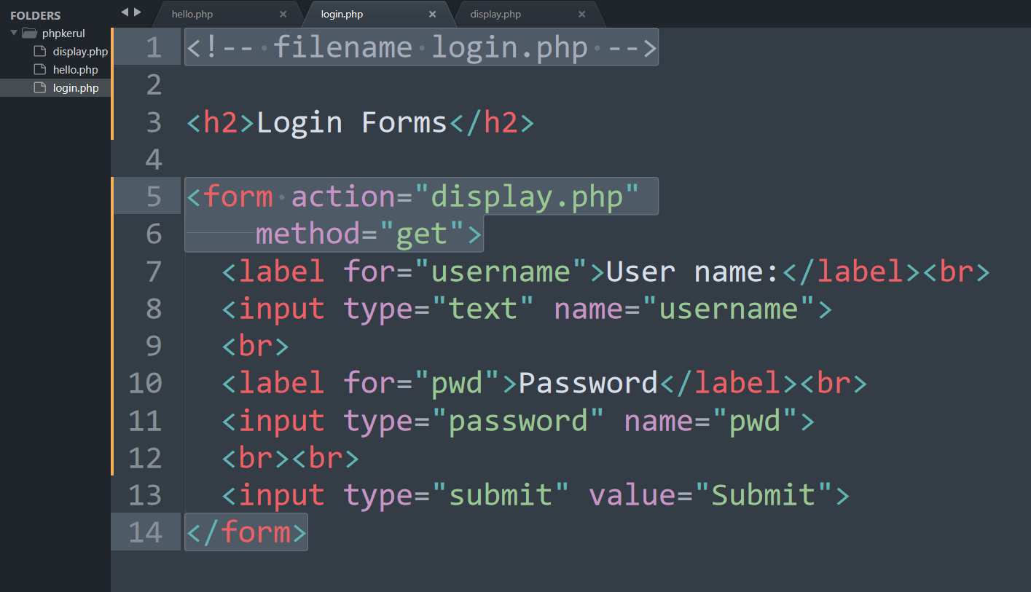
Example (Using GET Method)

Slide 106
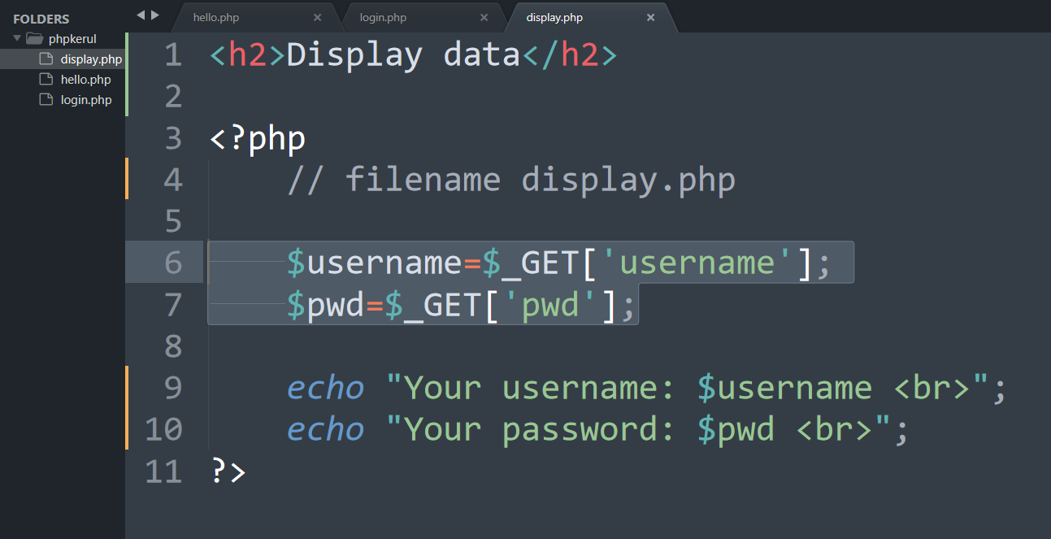
Display.php

Slide 107
Example (cont)

Slide 108
Example (Using POST Method)

Slide 109
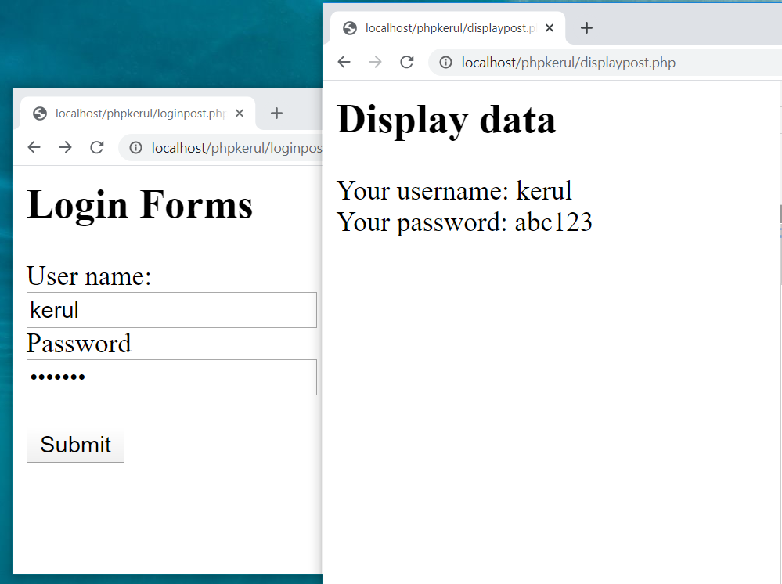

Slide 110
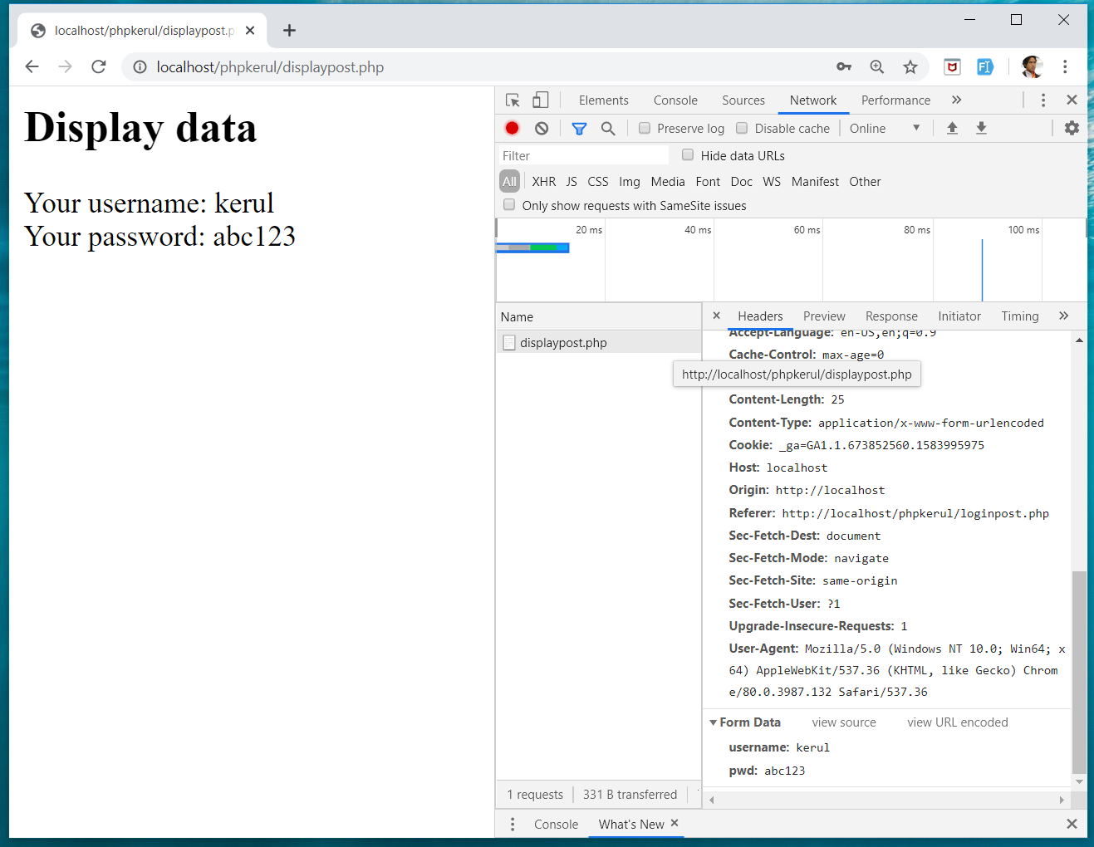
INSPECT TOOLS
F12

Slide 111
T07 SELECTION (PILIHAN) IF…Else
w
bit.ly/fstmtube

Slide 112
Comparison Operators
Operator | Meaning | Example
== | Equal to | ($num == 100)
!= | Not equal to | ($letter != ‘Z’)
< | Less than | ($num1 < $num2)
> | Greater than | ($mark > 80)
<= | Less than or equal to | ($sum <= 10)
>= | Greater than or equal to | ($sum >= $input)

Slide 113
Selection in PHP
if is a PHP reserved words to perform selection:
Simple if: for one choice selection
if…else: for two choices selection

Slide 114
Simple if
E.g.:
if ($grade == 'A')
echo 'Excellent';
else if ($grade == 'F')
echo 'Try again’;
else

Slide 115
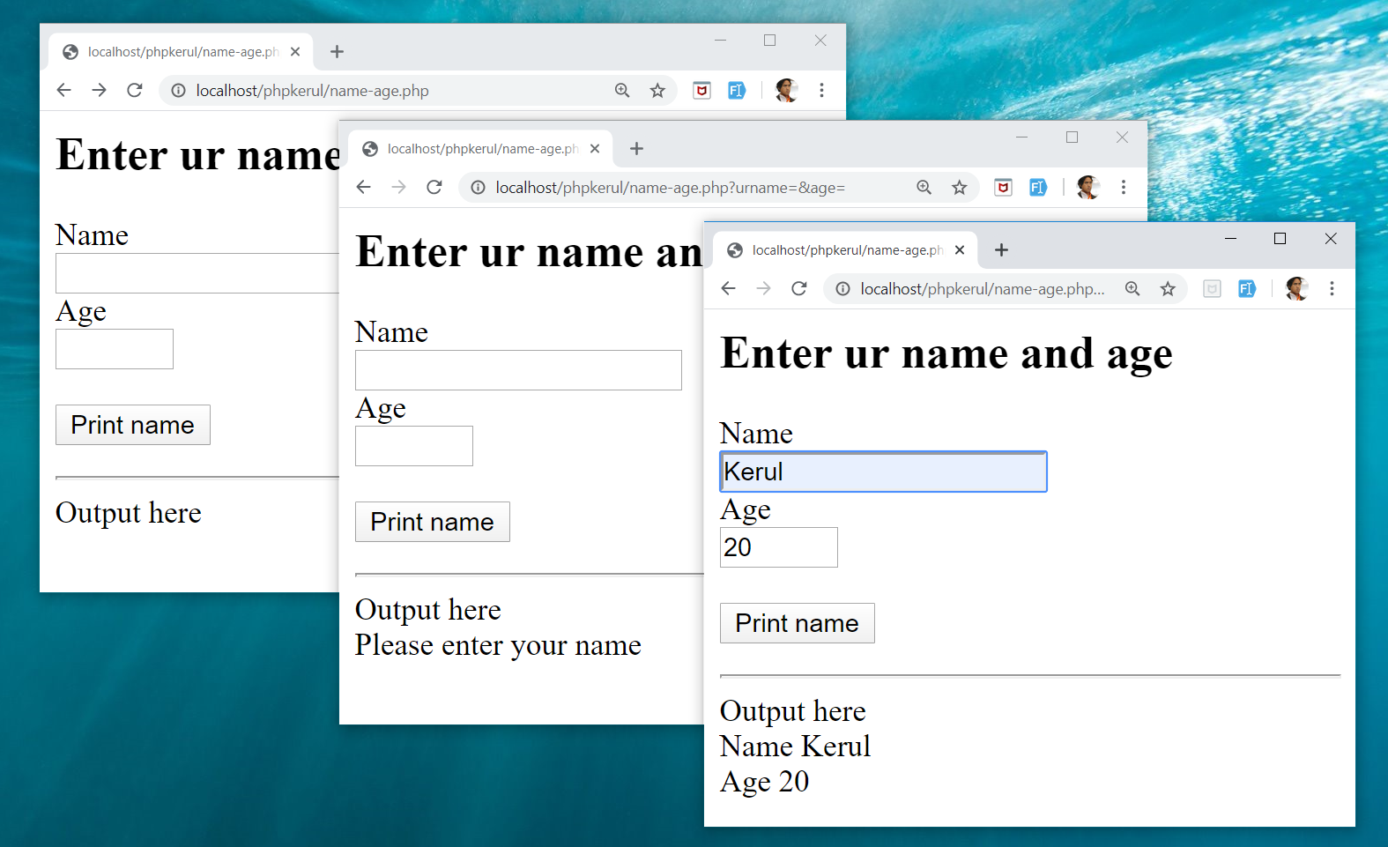
Example

Slide 116
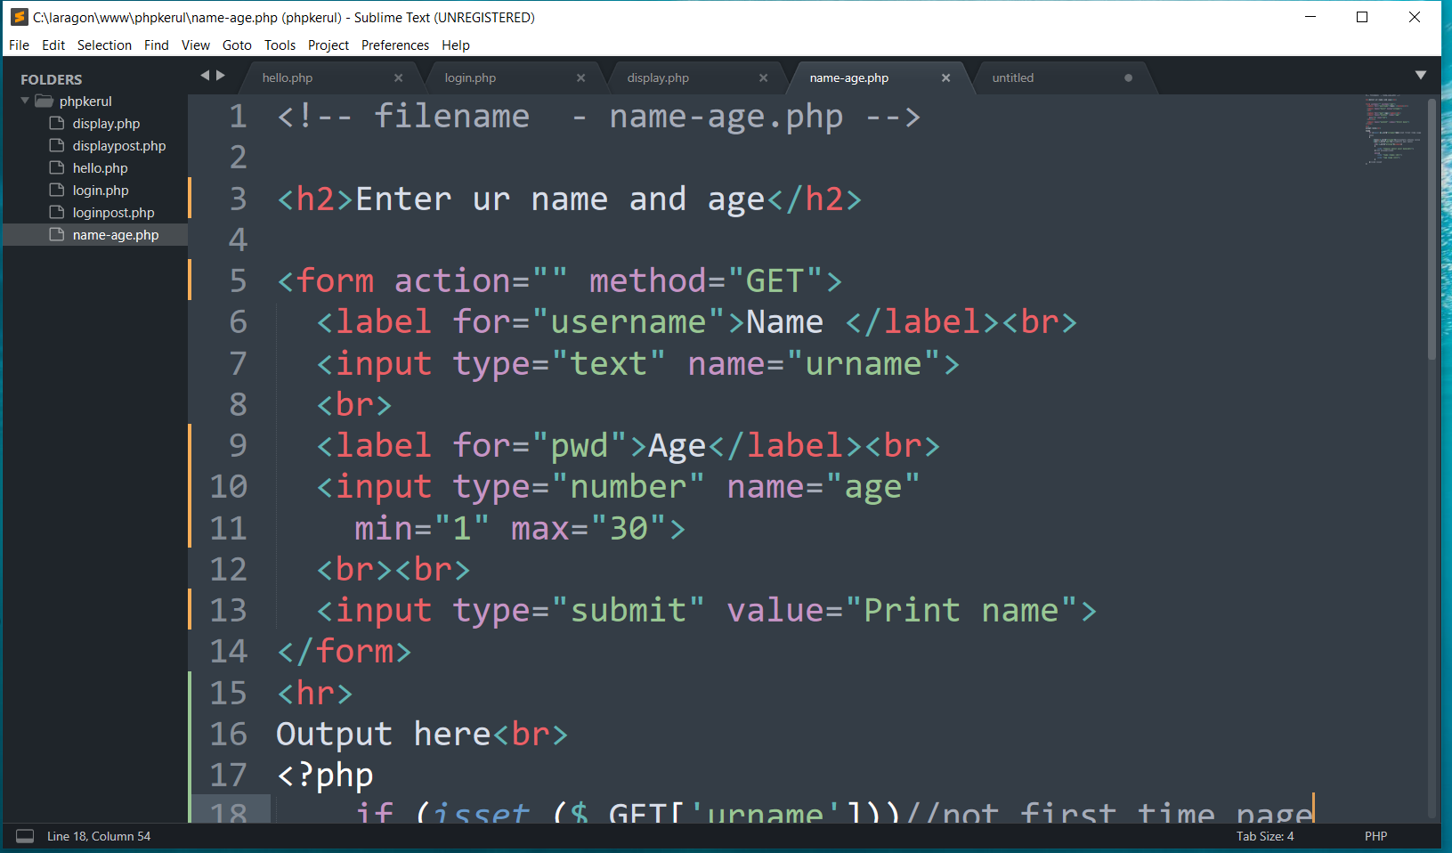
FORM (name-age.php )

Slide 117
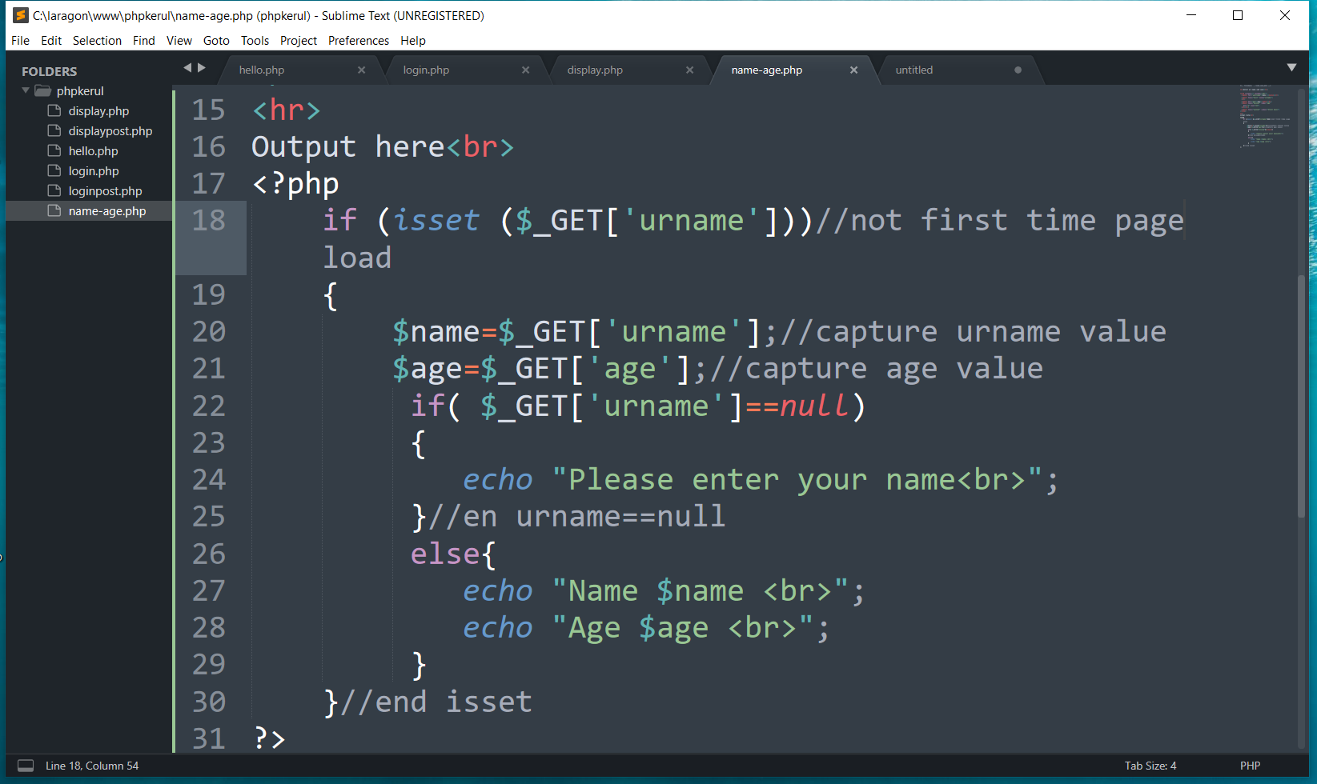
THE PHP IF…ELSE

Slide 118
T08 ITERATION (ULANGAN) FOR LOOp
w
bit.ly/fstmtube

Slide 119
Repetition in PHP
There are many ways of doing repetition. Three of them:
for
while and do…while
foreach

Slide 120
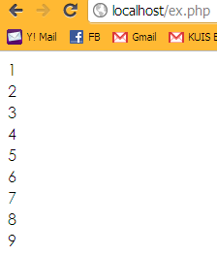
for structure
E.g.:
<?php
for ($i=1; $i<=9;$i++){
echo "$i<br>";
}
?>

Slide 121
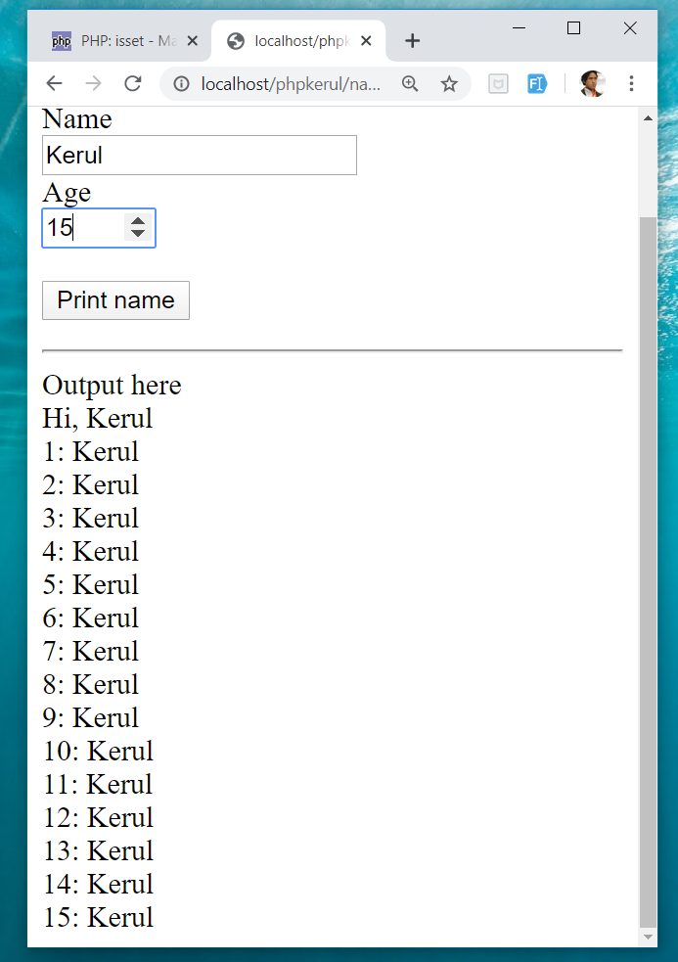
OUTPUT SAMPLE

Slide 122
T09 ARRAY (TATASUSUNAN) FOREACH
w
bit.ly/fstmtube

Slide 123
Introduction of Array
A variable is a storage area holding a number or text. The problem is a variable hold only one value.
An array is a special variable, which can store multiple values in one single variable.

Slide 124
Introduction of Array (cont)
If you have a list of items (a list of student names, for e.g.), storing the student names in single variables could look like this:
$std1="Anas"; $std2="Hajar"; $std3="Shah";

Slide 125
Introduction of Array
In PHP, there are 3 kind of arrays:
Numeric array - An array with a numeric index.
Assign using AUTOMATIC method.
Assign using MANUAL method.
Associative array - An array where each ID key is associated with a value.
Multidimensional array - An array containing one or more arrays.

Slide 126
Numeric Array
Assign using AUTOMATIC method (the index starts at 0).
$std = array("Anas", "Hajar", "Shah", "Nurul");
Assign using MANUAL method.
$std[0]="Anas"; $std[1]="Hajar"; $std[2]="Shah"; $std[3]="Nurul";

Slide 127
Example
<?php
$std[0]="Anas";
$std[1]="Hajar";
$std[2]="Shah";
$std[3]="Nurul";
echo $std[0] . " and " . $std[1] . " are students of FSTM.";
?>

Slide 128

Associative Array
$record['rollno' ]=5;
$record['name']="Kerul";
$record['phone’]=90346;

Slide 129


DISPLAY YEARS in DROPDOWN

Slide 130

SELECT
OPTION

Slide 131

FOREACH

Slide 132
T10 FILE UPLOAD (MUAT-NAIK FAIL)
w
bit.ly/fstmtube

Slide 133
DISCLAIMER
Codes are for demo purposes. Example showed here are only to validate the proof of concepts. Security aspect the demonstrated examples are beyond the coverage of these tutorials. You are advised to explore / sought after advanced topics of PHP web programming as the issues are covered in the advanced level.

Slide 134
move_uploaded_file function
The move_uploaded_file() function moves an uploaded file to a new location.
This function returns TRUE on success, or FALSE on failure.
Syntax:
move_uploaded_file(file,newloc)
file: Specifies the file name.
newloc: Specifies the new location (destination) for the file.

Slide 135
PHP.ini
In php settings ( locate file php.ini from Laragon), turn-on the file upload
file_uploads = On

Slide 136
UPLOAD FORM (ONLY FOR IMAGE)
<!DOCTYPE html> <html> <body> <form action= "saveupload.php" method="post" enctype="multipart/form-data"> Select image to upload: <input type="file" name="fileToUpload" <input type="submit" value="Upload Image" name="submit"> </form> </body> </html>

Slide 137

enctype
enctype="multipart/form-data" - POST request with file-upload, have to encode the data that forms the body of the request.
<input name="fileToUpload" type="file" > - the form control to choose a file and upload to server.

Slide 138

OUTPUT

Slide 139

PHP to store image in server
Source: www.w3schools.com/php/php_file_upload.asp

Slide 140

PHP to store image in server
Source: www.w3schools.com/php/php_file_upload.asp

Slide 141

PHP to store image in server
Source: www.w3schools.com/php/php_file_upload.asp

Slide 142
OUTPUT

Slide 143

T11 php OOP (PENGATURCARAAN BERASASKAN OBJEK)
bit.ly/fstmtube

Slide 144





OOP
Object Oriented Programming - We can imagine our surroundings are full of objects cars, trees, houses, etc. Same way there is object oriented programming concepts which assume everything as an object and implement a software/system parts using different objects.
w3schools

Slide 145



FUNCTION IN PHP
A function is a block of statements that can be used repeatedly in a program.
Without arguments.
With arguments.

Slide 146
MODULAR PHP FUNCTION
Tokenization
Post Tagging
Vocab
Outside Vocab
Annotati
Output generation
Input file

Slide 147
Class
PHP OOP
Methods
Properties
Classes and objects are the two main aspects of object-oriented programming.
Class
Method/function
Object call
Constructor
Static method/property
Inheritance

Slide 148

PHP Class

Slide 149

CLASS Method

Slide 150


PHP Class with Constructor

Slide 151
PHP Object Call

Slide 152


STATIC METHOD/PROPERTIES
w3schools

Slide 153

INHERITANCE
Inheritance in OOP = When a class derives from another class.
The child class will inherit all the public and protected properties and methods from the parent class. In addition, it can have its own properties and methods.
An inherited class is defined by using the extends keyword.
Parent /
Superclass
Child/Subclass

Slide 154

EXAMPLE ON INHERITANCE

Slide 155

INHERITANCE: PHP FRAMEWORK
bit.ly/fstmtubelaravel

Slide 156

T12 PREPARING MYSQL DATABASE SERVER (PANGKALAN DATA)
bit.ly/fstmtubephpmysql

Slide 157

T12 PREPARING MYSQL DATABASE SERVER (PANGKALAN DATA)
bit.ly/fstmtubephpmysql

Slide 158
DISCLAIMER
Codes are for demo purposes. Example showed here are only to validate the proof of concepts. Security aspect the demonstrated examples are beyond the coverage of these tutorials. You are advised to explore / sought after advanced/security topics of PHP web programming as these tutorials only for beginner level.

Slide 159
CONNECT TO MYSQL DATABASE
mysqli/PDO
E-book PHP&Mysqli get it from
khirulnizam@gmail.com or
http://fb.com/khirulnizam or
Instagram @kerul_net
These vids tutorial will cover mysqli/PDO

Slide 160

CHANGE DBSERVER ROOT PASSWORD

Slide 161

ENTER PASSWORD

Slide 162


START ALL

Slide 163


CREATE NEW DB

Slide 164

HEIDI SQL (MYSQL CILENT)

Slide 165

CREATE NEW TABLE
Right-click on dbname

Slide 166

TABLE STRUCTURE : STUDENTS
Table name: students
set auto_increment for field id

Slide 167

POPULATE DUMMY DATA
Right-click to insert new row

Slide 168
T13 DBCONNECT PDO (PANGKALAN DATA PDO)
bit.ly/fstmtubephpmysql

Slide 169
T13 DBCONNECT PDO (PANGKALAN DATA PDO)
bit.ly/fstmtubephpmysql

Slide 170
DISCLAIMER
Codes are for demo purposes. Example showed here are only to validate the proof of concepts. Security aspect the demonstrated examples are beyond the coverage of these tutorials. You are advised to explore / sought after advanced/security topics of PHP web programming as these tutorials only for beginner level.

Slide 171
CONNECT TO MYSQL DATABASE
mysqli/PDO
E-book PHP&Mysqli get it from
khirulnizam@gmail.com or
http://fb.com/khirulnizam or
Instagram @kerul_net
These vids tutorial will cover mysqli/PDO

Slide 172

WHY PDO ?
PDO – PHP Data Object
Support different database
mysqli – only for MySQL
database connection
https://www.php.net/manual/en/book.pdo.php

Slide 173

TEST DBCONNECT TO DATABASE

Slide 174

HOW TO DISPLAY ALL RECORDS

Slide 175

EMBED SQL STATEMENT

Slide 176

SUBSCRIBE FSTM KUIS CHANNEL

Slide 177
T14 DBCONNECT using mysqli (Pangkalan Data mysqli)
bit.ly/fstmtubephpmysql

Slide 178
STAY HOME5, SAVE MALAYSIA! t14: mysqli
bit.ly/fstmphpmysqli

Slide 179
DISCLAIMER
Codes are for demo purposes. Example showed here are only to validate the proof of concepts. Security aspect the demonstrated examples are beyond the coverage of these tutorials. You are advised to explore / sought after advanced/security topics of PHP web programming as these tutorials only for beginner level.
Suitable to view in DESKTOP

Slide 180
CONNECT TO MYSQL DATABASE
mysqli
E-book PHP&Mysqli get it from
khirulnizam@gmail.com or
http://fb.com/khirulnizam or
Instagram @kerul_net
These vids tutorial will cover mysqli

Slide 181
3-tier – DATABASE CONNECTION
Tier3 : Database
Tier1 : Client/browser
Tier2 : Middleware (Webserver + PHP)

Slide 182

CREATE NEW DB

Slide 183

PREPARE DATABASE NAME & TABLE

Slide 184
mysqli_connect ( )
<?php
$servername = "localhost";//server location / IP number
$username = "root";//db admin username
$password = "abcd1234";//password for db admin username
$dbname = "newsystem";//database name
// Create connection
$conn = mysqli_connect($servername, $username,
$password, $dbname);

Slide 185

mysqli_connect ( )

Slide 186

TEST SQL COMMANDS

Slide 187
MSQLI FUNCTIONS
$result = mysqli_query($conn, $sql)
PHP.net/mysqli_query : Performs an SQL query on the database
if (mysqli_num_rows($result) > 0)
PHP.net/mysqli_num_rows : Gets the number of rows in a result
while($row = mysqli_fetch_assoc($result)) {
PHP.net/mysqli_fetch_assoc : Fetch a result row as an associative array

Slide 188
Associative Array
$record['rollno']=5;
$record['name']="Kerul";
$record['phone’]=90346;

Slide 189

EMBED SQL IN PHP

Slide 190

DISPLAY RESULT SET

Slide 191
SUBSCRIBE FSTM KUIS CHANNEL

Slide 192
T15 SEARCH IN DB (Carian dalam DB)
bit.ly/fstmtubephpmysql

Slide 193
DISCLAIMER
Codes are for demo purposes. Example showed here are only to validate the proof of concepts. Security aspect the demonstrated examples are beyond the coverage of these video tutorials. You are advised to explore / sought after advanced/security topics of PHP web programming as these tutorials only for beginner level.
Suitable to view in DESKTOP

Slide 194
CONNECT TO MYSQL DATABASE
mysqli
E-book PHP&Mysqli get it from
khirulnizam@gmail.com or
http://fb.com/khirulnizam or
Instagram @kerul_net
Video tutorial will cover mysqli

Slide 195
Code & Slides github.com/khirulnizam/ newsystem

Slide 196

CODE: search.php

Slide 197

POPULATE DATA INSIDE TABLE

Slide 198
Next

Slide 199

T16 BOOTSTRAP TEMPLATE
bit.ly/fstmtphpmysqli

Slide 200
EXAMPLE OF IMPLEMENTATION

Slide 201
GITHUB
https://github.com/khirulnizam/newsystem

Slide 202
DISCLAIMER
Codes are for demo purposes. Example showed here are only to validate the proof of concepts. Security aspect the demonstrated examples are beyond the coverage of these video tutorials. You are advised to explore / sought after advanced/security topics of PHP web programming as these tutorials only for beginner level.
Suitable to view in DESKTOP

Slide 203
CONNECT TO MYSQL DATABASE
mysqli
E-book PHP&Mysqli get it from
khirulnizam@gmail.com or
http://fb.com/khirulnizam or
Instagram @kerul_net
Video tutorial will cover mysqli

Slide 204
Include php
include ("header.php");
<our content>
include ("footer.php");

Slide 205
startbootstrap.com/themes/sb-admin-2/

Slide 206
EXAMPLE OF IMPLEMENTATION

Slide 207

T17 INSERT RECORD (MASUKKAN REKOD BAHARU)
bit.ly/fstmtphpmysqli

Slide 208
EXAMPLE OF IMPLEMENTATION

Slide 209
GITHUB
https://github.com/khirulnizam/newsystem

Slide 210
DISCLAIMER
Codes are for demo purposes. Example showed here are only to validate the proof of concepts. Security aspect the demonstrated examples are beyond the coverage of these video tutorials. You are advised to explore / sought after advanced/security topics of PHP web programming as these tutorials only for beginner level.
Suitable to view in DESKTOP

Slide 211
CONNECT TO MYSQL DATABASE
mysqli
E-book PHP&Mysqli get it from
khirulnizam@gmail.com or
http://fb.com/khirulnizam or
Instagram @kerul_net
Video tutorial will cover mysqli

Slide 212
OVERVIEW

Slide 213

forminsert.php

Slide 214

forminsert.php

Slide 215

forminsert.php

Slide 216

INSERT INTO

Slide 217

T18 SHOW DETAILS (Paparan semua data rekod)
bit.ly/fstmphpbootstrap

Slide 218

OVERVIEW

Slide 219
DISCLAIMER
Codes are for demo purposes. Example showed here are only to validate the proof of concepts. Security aspect the demonstrated examples are beyond the coverage of these video tutorials. You are advised to explore / sought after advanced/security topics of PHP web programming as these tutorials only for beginner level.
Suitable to view in DESKTOP

Slide 220
CONNECT TO MYSQL DATABASE
mysqli
E-book PHP&Mysqli get it from
khirulnizam@gmail.com or
http://fb.com/khirulnizam or
Instagram @kerul_net
Video tutorial will cover mysqli

Slide 221
Code & Slides github.com/khirulnizam/ newsystem

Slide 222
OVERVIEW

Slide 223
search-admin.php

Slide 224


Slide 225
formshow.php

Slide 226


Slide 227


Slide 228


Slide 229
Code & Slides github.com/khirulnizam/ newsystem

Slide 230

T19 UPDATE RECORD (Kemaskini data rekod)
bit.ly/fstmphpbootstrap

Slide 231

UPDATE RECORD PROCESS
search-admin.php
id
id

Slide 232
OVERVIEW
Cancel
Save Record

Slide 233
DISCLAIMER
Codes are for demo purposes. Example showed here are only to validate the proof of concepts. Security aspect the demonstrated examples are beyond the coverage of these video tutorials. You are advised to explore / sought after advanced/security topics of PHP web programming as these tutorials only for beginner level.
Suitable to view in DESKTOP

Slide 234
CONNECT TO MYSQL DATABASE
mysqli
E-book PHP&Mysqli get it from
khirulnizam@gmail.com or
http://fb.com/khirulnizam or
Instagram @kerul_net
Video tutorial will cover mysqli

Slide 235
Code & Slides github.com/khirulnizam/ newsystem

Slide 236

UPDATE COMMAND SQL

Slide 237

T20 DELETE RECORD (Padam rekod)
bit.ly/fstmphpbootstrap

Slide 238

UPDATE RECORD PROCESS
search-admin.php
id
confirmdelete( )
id

Slide 239
OVERVIEW
Save Record

Slide 240
DISCLAIMER
Codes are for demo purposes. Example showed here are only to validate the proof of concepts. Security aspect the demonstrated examples are beyond the coverage of these video tutorials. You are advised to explore / sought after advanced/security topics of PHP web programming as these tutorials only for beginner level.
Suitable to view in DESKTOP

Slide 241
CONNECT TO MYSQL DATABASE
mysqli
E-book PHP&Mysqli get it from
khirulnizam@gmail.com or
http://fb.com/khirulnizam or
Instagram @kerul_net
Video tutorial will cover mysqli

Slide 242
Code & Slides github.com/khirulnizam/ newsystem

Slide 243

UPDATE COMMAND SQL

Slide 244
T21 INNER JOIN (Gabungan dua jadual)

Slide 245


1-Many relationship

Slide 246
DISCLAIMER
Codes are for demo purposes. Example showed here are only to validate the proof of concepts. Security aspect the demonstrated examples are beyond the coverage of these video tutorials. You are advised to explore / sought after advanced/security topics of PHP web programming as these tutorials only for beginner level.
Suitable to view in DESKTOP

Slide 247
CONNECT TO MYSQL DATABASE
mysqli
E-book PHP&Mysqli get it from
khirulnizam@gmail.com or
http://fb.com/khirulnizam or
Instagram @kerul_net
Video tutorial will cover mysqli

Slide 248
Code & Slides github.com/khirulnizam/ newsystem

Slide 249

DISPLAY OPTIONS FROM TABLE TO DROP-DOWN

Slide 250

OUTPUT

Slide 251
T22 INNER JOIN DISPLAY (Papar gabungan dua jadual)

Slide 253
1-Many relationship

Slide 254
DISCLAIMER
Codes are for demo purposes. Example showed here are only to validate the proof of concepts. Security aspect the demonstrated examples are beyond the coverage of these video tutorials. You are advised to explore / sought after advanced/security topics of PHP web programming as these tutorials only for beginner level.
Suitable to view in DESKTOP

Slide 255
CONNECT TO MYSQL DATABASE
mysqli
E-book PHP&Mysqli get it from
khirulnizam@gmail.com or
http://fb.com/khirulnizam or
Instagram @kerul_net
Video tutorial will cover mysqli

Slide 256
1-Many relationship

Slide 257

SQL: INNER JOIN

Slide 258

OUTPUT

Slide 259


MOBIRISE
Mobirise – a free web design studio that support HTML5 & Bootstrap’s famous ‘block’ design.

Slide 260

MOBIRISE
Done with the talking, lets walk the talk… ;)

Slide 261

Select theme

Slide 262

Start here

Slide 263

Select block

Slide 264


Slide 266

MOBIRES- CHANGING IMAGE

Slide 267

MOBIRES- TEXT EDITING

Slide 268


Slide 269


Slide 270

Thank you very much
Newton keep asking, Why apple FALL from tree?
Everybody asks silly questions before becoming a star…

